Slide 1
Leveraging Machine Learning Capabilities for the Characterization of Irradiated Uranium: A Case Study of Prediction Methods for Nuclear Safeguards and Nuclear Forensics
A dissertation defense by: Adam Drescher
On: Monday, December 2nd, 2019
Committee:
Sheldon Landsberger (Supervisor), Ken Dayman (Co-Supervisor), William Charlton, George Biros, Derek Haas
Notes:
I would like to thank you all for taking the time to listen to my dissertation presentation today. This specific focus of this presentation is: “Leveraging machine learning capabilities for the characterization of irradiated uranium” and how this scenario can serve as “A case study of prediction methods for nuclear safeguards and nuclear forensics”.

Slide 2
Contents
Introduction
General problem I aim to solve.
Specific scenario I consider related to this problem.
Set of questions I will answer.
Motivating Scenario
The shortcomings of existing methods.
Theory
Prerequisite technical information.
Methods
Data collection, data processing, experimental setup, etc.
Results
My findings and the answers to the introduction questions.
Future Work
A proposal for a real-world system.
Notes:
These are the sections of this presentation. I will start by introducing the general issues that this work aims to solve, and then discuss the specific scenario that I use to answer this problem. I will then present an existing method for solving this scenario and highlight its shortcomings as a motivation for my method. I will then describe the prerequisite technical theoretical information essential to this problem, the methods that I employed, the results that I have achieved, and finally I will present a brief proposal for future work that will build on what I have done towards a real-world deployable system.

Slide 3
Introduction: Problem Statement
Example problems in nuclear engineering, forensics, & safeguards
Re-verification of spent nuclear fuel:
Burnup, cooling time, reactor type, shielding, enrichment, etc.
Characterization of nuclear weapon debris:
Fractionation, detonation height, detonation coordinates, weapon composition, etc.
Non-proliferation monitoring of nuclear fuel cycle for power production
Determining environmental contamination resulting from nuclear fuel cycle activities
Q: What do all of these problems have in common?
A: Multiple degrees of freedom in unknown parameters which could influence measurements and make direct calculation of a target value intractable without dangerous assumptions.
Prediction methods which are insensitive to unknowns would therefore greatly improve many applications in nuclear engineering.
This presentation considers a sample “problem in a box” – determining enrichment of irradiated uranium if the decay and/or irradiation times are unknown.
Notes:
In this slide, I present a few sample problems in nuclear engineering. I discuss the fact that each one has multiple parameters that might be unknown or loosely constrained. This makes direct calculation of a quantity intractable without assumptions for each parameter. This motivates the need for prediction methods in nuclear engineering which are insensitive to the unknown parameters. To further investigate this, I develop the “problem in a box” – determination of enrichment of irradiated uranium with unknown decay and irradiation times.

Slide 4
Introduction: Problem Statement
Questions specifically addressed here
Is it feasible to predict uranium enrichment based off gamma-ray emissions if decay time (t_{dec}) is unknown?
Which machine learning algorithms yield the best models of enrichment?
What features do models select as important in the gamma-ray spectrometry data?
How much data is required to train models?
Is data truncation to speed up computation time feasible without loss of performance?
How well do models generalize to new parameter spaces: e.g. different irradiation times (t_{irr})?
New questions raised by these results
What shortcomings, overlooked scenarios, or other unanswered questions exist in my own analysis? (All potential future work launch points)
What are the implications of this method for future applications?
What steps are necessary to extend this process to a real-world scenario?
Notes:
These are the questions that I specifically address in this work, and the new questions that these results ask.

Slide 5
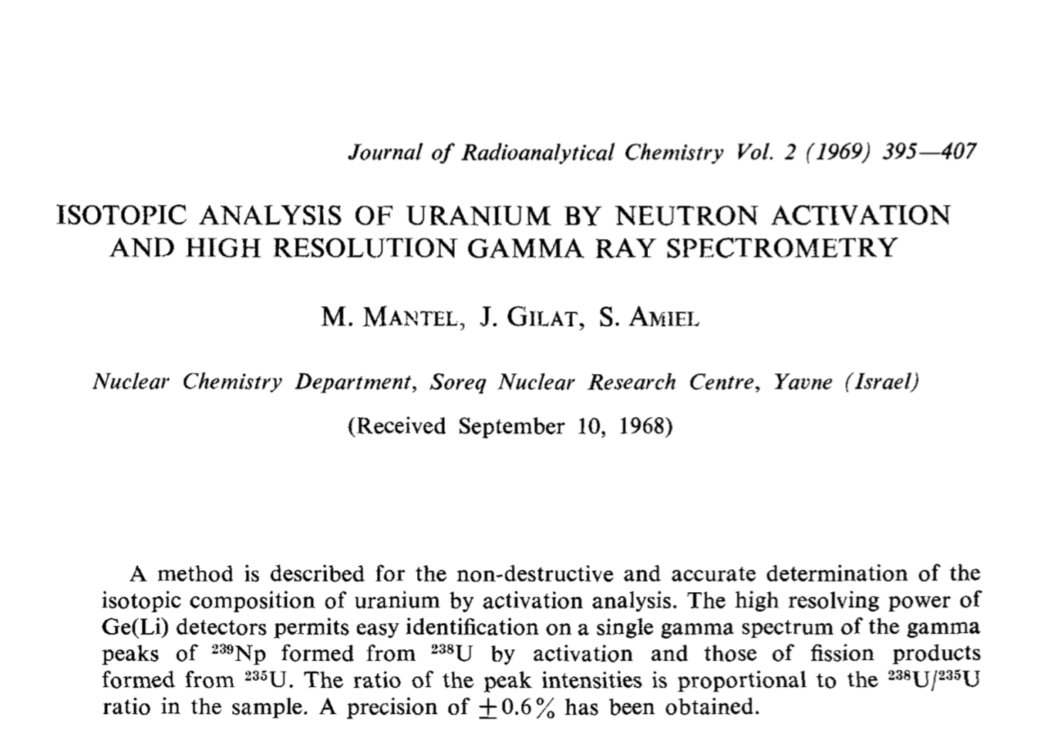
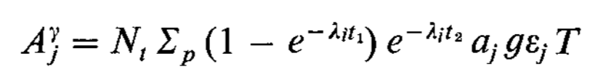
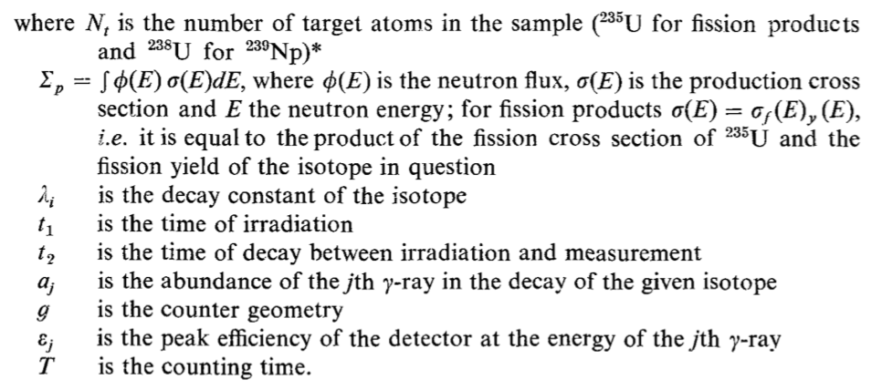
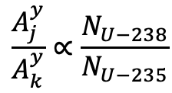
Motivating Scenario: Mandel et al.
Nuclide | Energy [keV]
²³⁹Np | 105
²³⁹Np | 210
²³⁹Np | 278
⁹⁹Mo | 140
¹³³I | 530
⁹¹Y | 556
⁹⁷Nb | 658
⁹⁷Nb | 743
¹³²I | 773
²³⁸U(n, γ)²³⁹U→^{β} ²³⁹Np
²³⁵U(n, fission) →FP₁, FP₂
$$\frac{A_{j}^{y}}{A_{k}^{y}}∝\frac{N_{U−238}}{N_{U−235}}$$
Notes:
The specific “problem in a box” that I consider in this work is determining the enrichment of an irradiated uranium sample via gamma-ray spectrometry. This problem has been previously studied by Mandel et al. in 1969. Mandel et al. identified a set of 9 photons which can be used to calculate the uranium isotope ratio.
The equation presented here shows the net counts of a given photon based on number of target atoms, irradiation time, decay time, counting time, etc. Note the dependence on both the irradiation time and decay time of the specimen.
The idea behind Mandel’s method is that the ratio of photon counts which are indirectly caused by U-238 to those which are indirectly caused by U-235 is correlated with the true U-238/U-235 ratio of the material itself if all other terms are fixed. In this set of photons, those which are caused by U-238 are the three Np-239 photons (105 keV, 210 keV, and 278 keV). The other six photons are primary fission product emissions, which are created by U-235 fission.

Slide 6
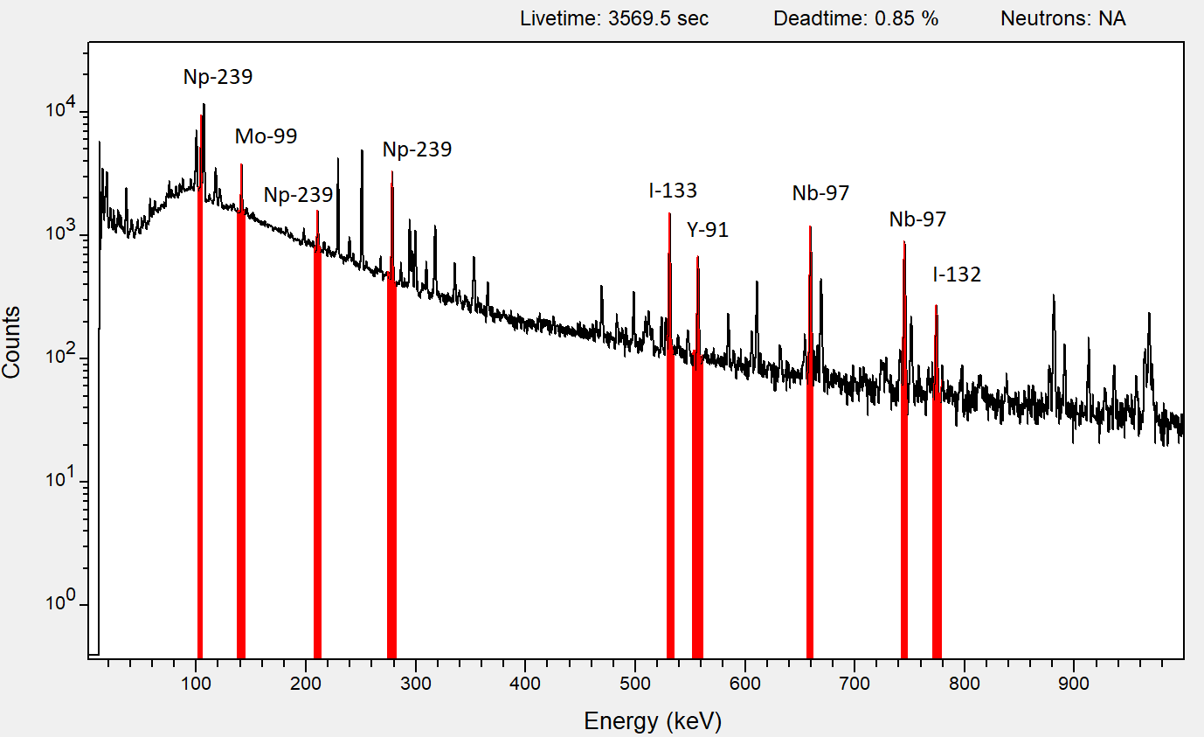
Motivating Scenario: Mandel et al.
Nuclide | Energy [keV]
²³⁹Np | 105
²³⁹Np | 210
²³⁹Np | 278
⁹⁹Mo | 140
¹³³I | 530
⁹¹Y | 556
⁹⁷Nb | 658
⁹⁷Nb | 743
¹³²I | 773
Procedure
Measure net areas of these nine photopeaks at several enrichments.
Calculate 18 photopeak ratios (Np/FP).
Linear regression to produce 18 calibration curves.
Perform enrichment predictions on new samples with these curves. The average is the ultimate prediction.
Quantify method performance via statistical analysis of results.
Notes:
The procedure for Mandel’s method of enrichment determination is as follows: (read bullet points verbatim). This figure shows a sample gamma-ray spectrum of my experimental data, with each of the relevant photopeaks highlighted.

Slide 7
Motivating Scenario: Mandel et al.
Nuclide | Energy [keV]
²³⁹Np | 105
²³⁹Np | 210
²³⁹Np | 278
⁹⁹Mo | 140
¹³³I | 530
⁹¹Y | 556
⁹⁷Nb | 658
⁹⁷Nb | 743
¹³²I | 773
Use existing method of Mandel et al. for enrichment determination
Limitations:
Viable only for enrichments ~<20% ²³⁵U
Requires fixed t_{dec}
Assumes thermal neutron field.
Measure the errors introduced as t_{dec} is no longer fixed.
Notes:
Here, I will re-create the method of Mandel et al. with my own set of experimental data consisting of gamma-ray spectra of irradiated uranium samples at multiple enrichment levels. I will show how well the method works for the exact scenario it was designed for, wherein the decay time is fixed at 24 hours, and then I will show the increase in errors that occurs when this constraint on the decay time is removed.

Slide 8
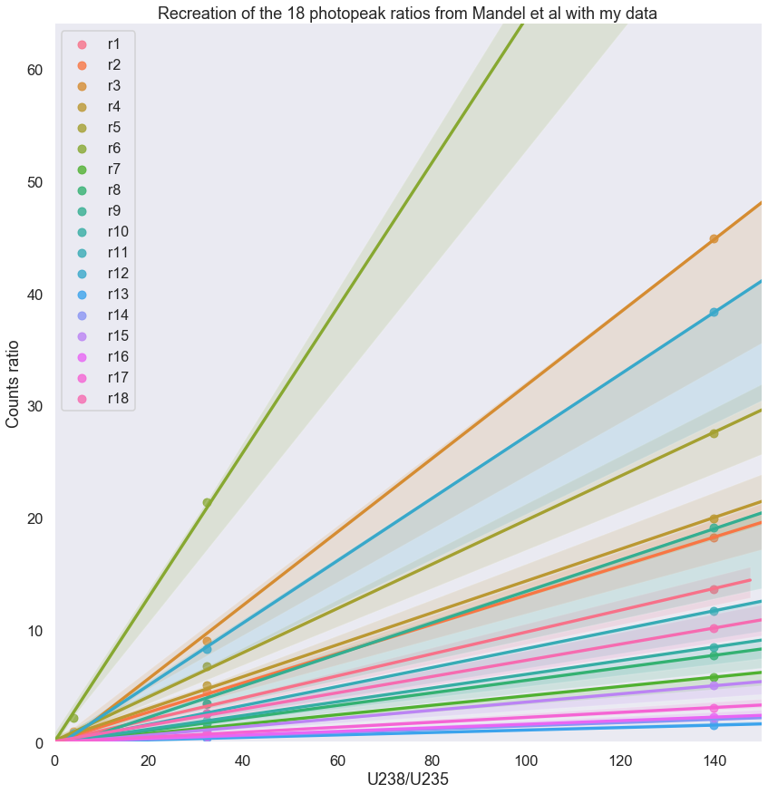
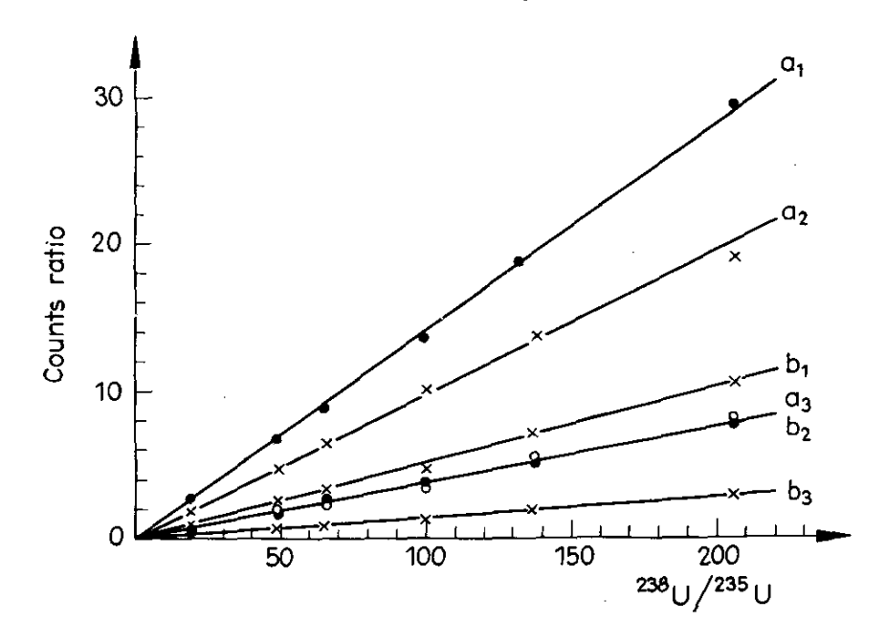
Motivating Scenario: Mandel et al.
Recreation w/ my data at 24 hr decay
Generated calibration curves with my data for enrichments of 0.71%, 3%, and 20% ²³⁵U.
Comparison of all 18 of my calibration curves vs 6 of the curves developed in Mandel et al.
Mandel et al.
Notes:
The figure on the right of this slide is taken from the paper of Mandel et al., and shows six of the calibration curves that they used for enrichment predictions. The figure on the left shows my recreation of all 18 of the calibration curves with my experimental data. I fit each regression curve with the 24 hour decay data of 0.71% (natural) uranium and 20% uranium, and then use those curves to perform predictions on the uranium isotope ratio associated with 3% uranium.

Slide 9
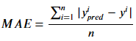
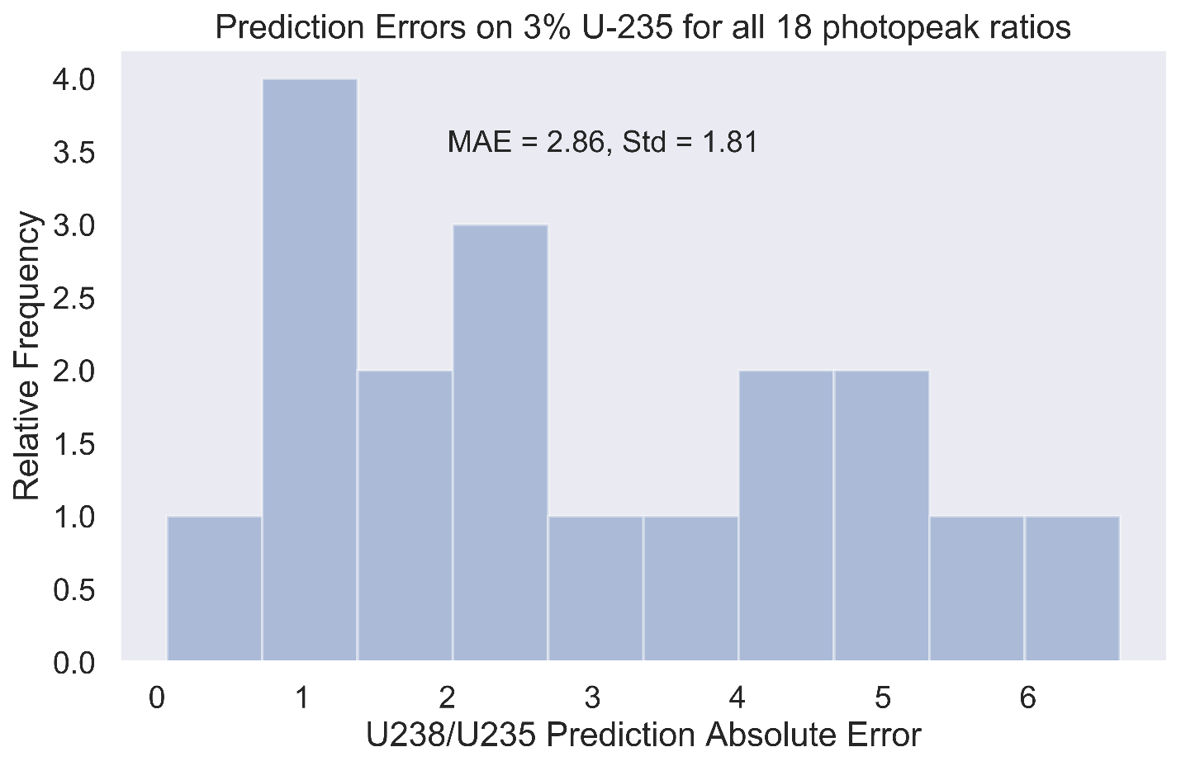
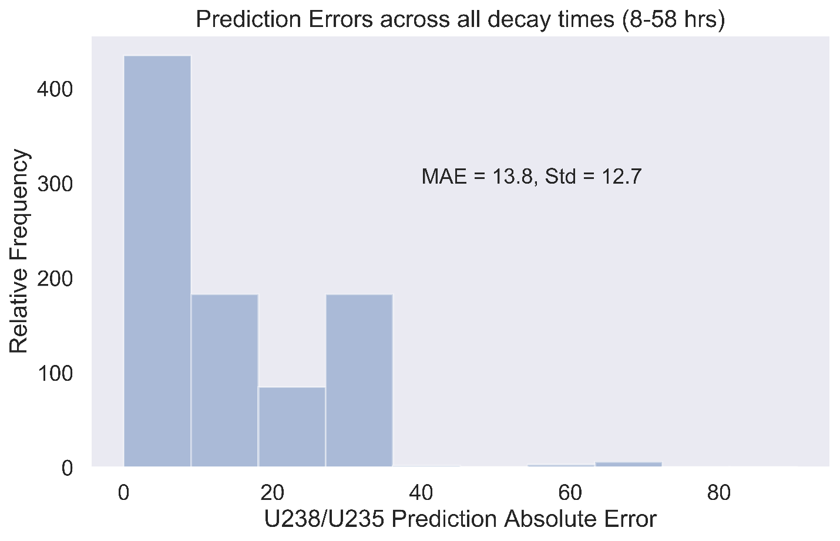
Motivating Scenario: Mandel et al.
My data (2 scenarios). In each, we calibrate off 0.71% and 20% to predict 3%:
One-hour spectra each of 0.71%, 3%, and 20% ²³⁵U at 24 hours of decay.
1,000 three-minute spectra each of 0.71%, 3%, and 20% ²³⁵U at decay times ranging 8 hr to 58 hr.
Ensemble prediction: 33.22±1.81
(2.8% to 3.2% enrichment)
Ensemble prediction: 22.5±12.7
(2.8 to 9.3% enrichment)
Decay time fixed at 24 hr
Decay time ranging from 8 hr to 58 hr
Significant degradation in performance as restriction on t_{dec} is removed
Notes:
Here I compare the performance of this method when making prediction on gamma-ray spectra collected at exactly 24 hours of decay to gamma-ray spectra collected every hour from 8 hours to 58 hours of decay. These plots show the frequency distribution of absolute errors in prediction for each of the 18 photopeak ratio curves. On the left, when the decay time is fixed at 24 hours, the absolute errors in prediction range from ~0-6, with an MAE score of 2.86. On the right, when the decay time is allowed to vary, the prediction errors now range from ~0-30, with a few errors reaching above 60, and an MAE score of 13.8. These results demonstrate two important points: 1) the prediction method of Mandel et al. works very well if we can be sure that all decay times are the same, and 2) this method has a significant performance degradation as the decay time constraint is relaxed – it is therefore NOT invariant to decay time.

Slide 10
Motivating Scenario: Mandel et al.
My method improves on Mandel et al. in the following ways:
Invariant performance across a range of t_{dec} and t_{irr} values.
Usable with spectra collected in much less than one hour.
Usable across all enrichment values.
Same scenario, same set of data, but allows for more unrestricted values (versus Mandel et al.).
Notes:
And so my method will improve on Mandel et al. in the following ways: (READ SLIDE VERBATIM)

Slide 11
Theory
Machine Learning:
Regularized Linear Models
Decision Tree Models
Ensemble Models
Bias/Variance Tradeoff
Principal Component Analysis
Nuclear Engineering
Neutron Activation Analysis
Bateman equations for U content
Gamma-ray spectrometry

Slide 12
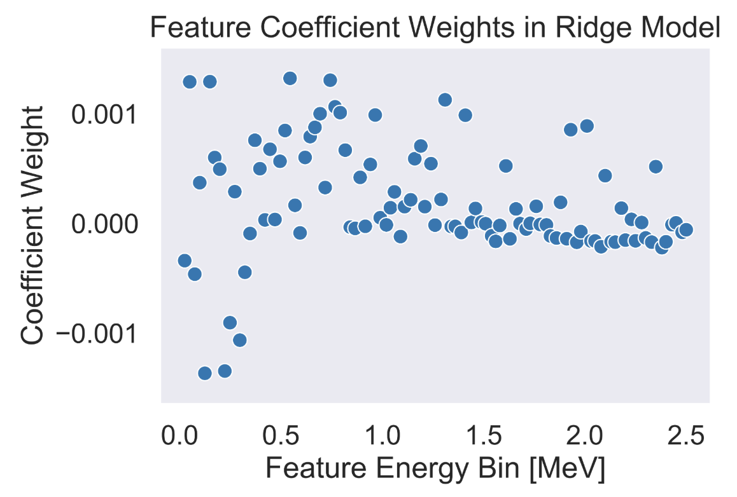
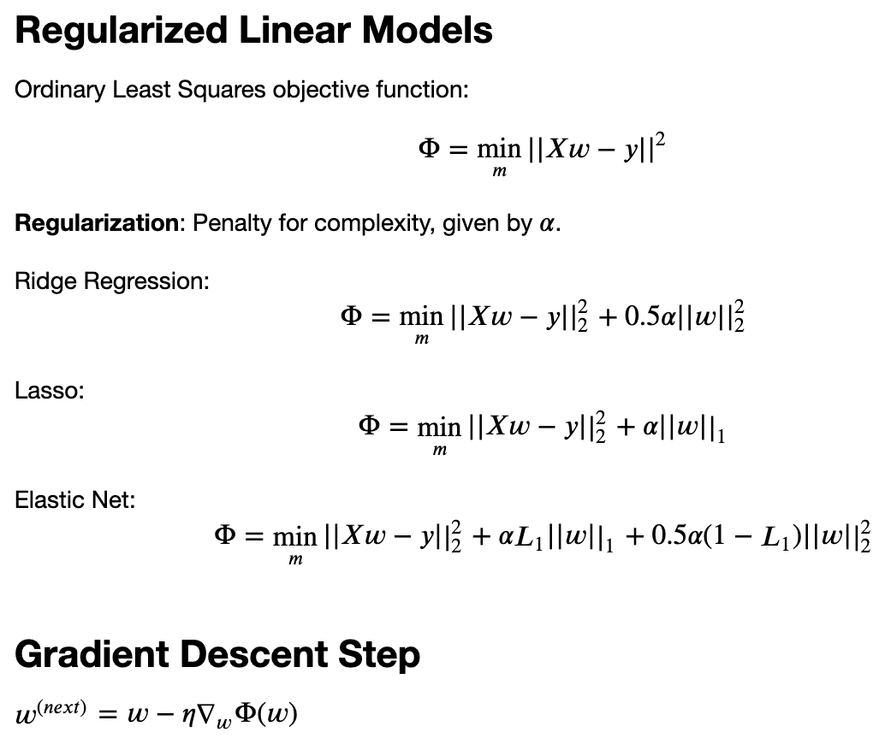
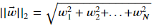
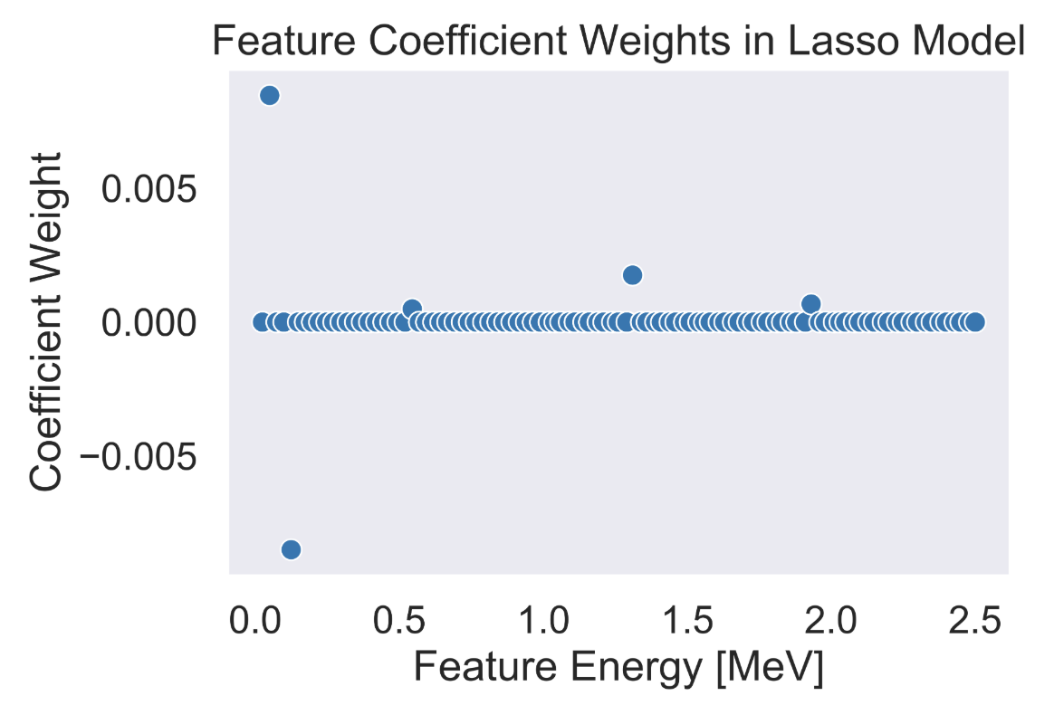
Theory: Regularized Linear Models
L₂ norm produces models with many small magnitude coefficients.
L₁ norm preferentially produces sparse models with few nonzero coefficients.
Notes:
The first class of machine learning algorithms I would like to discuss are the regularized linear models. Regularized linear models are an extension of ordinary least squares, where the model is selecting feature coefficient values w which minimize the objective function phi such that the difference between the predictions Xw and the target values y is minimized. Regularization can be described as a penalty for complexity. The way that this penalty is accomplished is by introducing a regularization parameter into the objective function and multiplying it by the magnitude of the feature coefficient weights. The regularization parameter is a user-defined hyperparameter, meaning that its value is chosen to control the strength of the regularization.
There are three different regularized linear models that I considered in this work. They differ only in the form of the regularization parameter that manifests in the objective function of each model. Ridge regression utilizes the L2 norm, lasso utilizes the L1 norm, and elastic net uses a linear combination of both the L1 and L2 norms.
Computational complexity O(m,n^2) assuming m>n

Slide 13
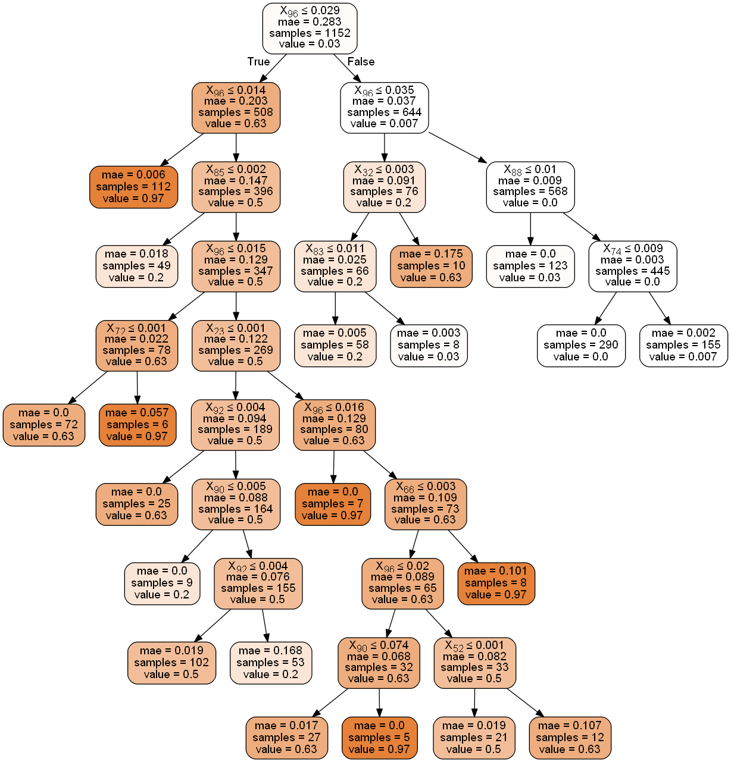
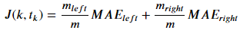
Theory: Decision Tree Models
Each node decision threshold evaluates feature k at threshold t_{k}.
Left branches correspond to True
Right branches correspond to False
Regularization options include: maximum depths, max # of leaves, min samples per leaf, etc.
Notes:
The next algorithm is the decision tree regressor. Decision tree regressors operate by identifying a feature/threshold-value pair which maximally splits the data into the cleanest possible subsets. This is shown by the first equation, where a (k, tk) pair is selected such that the instance-weighted mean absolute errors on both sides of the split are at a minimum. This splitting process iteratively continues down each branch of the decision tree until leaf nodes are formed to terminate each branch.
M is num of instances, n is num of features
Decision tree training is O(n*mlog(m))
Decision tree predicting is O(log_{2}(m))

Slide 14
Theory: Ensemble Methods – Random Forests
Large number of more strongly regularized decision trees.
Favorable exchange of increased bias for reduced variance when compared to decision tree.
Notes:
One of the primary shortcomings of decision trees is that they have a tendency to overfit to the training data. A single decision tree could, in principle, become extremely complex and identify a leaf node which perfectly predicts the values of every single instance in the training set. Regularization of the hyperparameters which control decision tree growth can partially overcome this. Alternatively, one could use random forests instead of decision trees. Random forests are designed to address the primary shortcoming of decision trees – the tendency to overfit the training data. The main idea is to create a large number of more strongly regularized decision trees. This prevents any individual decision tree from overfitting the training data and thus prevents excessive variance. However, since each tree is more strongly regularized it is less likely to fully capture all of the nuances of the data, and therefore each individual tree will have higher bias. As a result, the entire ensemble has a slight increase in bias as compared to decision trees, but with a substantial reduction in variance. This is generally considered a favorable tradeoff.
Computational complexity O(mtree*ntry*mlog(m))
With maximum depth: O(mtree*ntry*d*m)

Slide 15
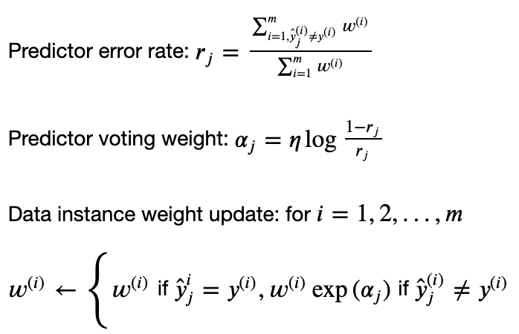
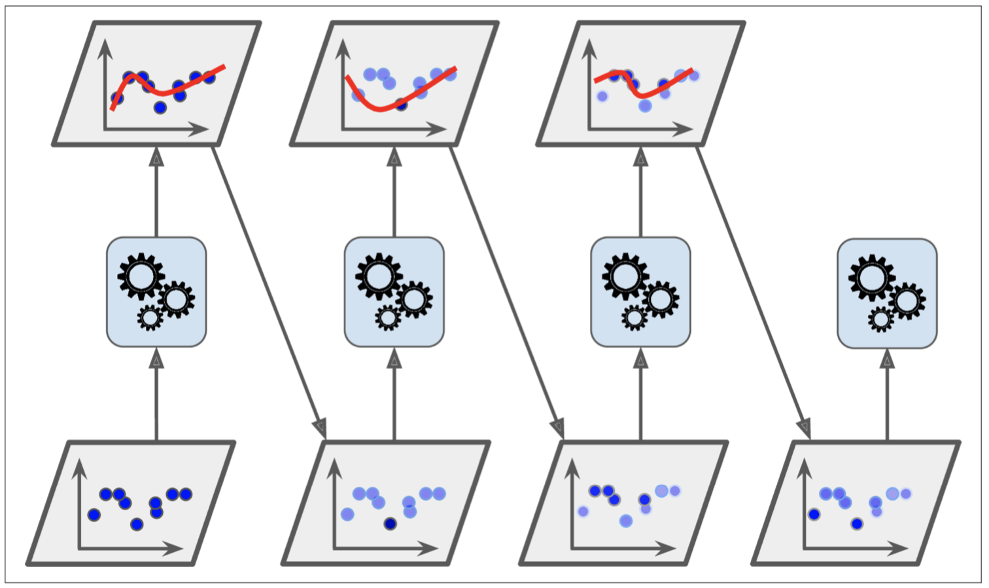
Theory: Ensemble Methods – Adaptive Boosting
Instances with high prediction error have increased weights for the next serial model.
Notes:
The next algorithm is another ensemble based method using decision trees as the base estimator. Adaptive boosting is an alternative to random forests where each tree in the ensemble influences how the next tree is built. Specifically, for the first model, the training instances which have the highest prediction errors have their weights updated in the objective function of the second model, and so on. The entire ensemble then votes on the ultimate prediction of an instance with voting weights dependent on the relative prediction errors of each individual model during training.

Slide 16
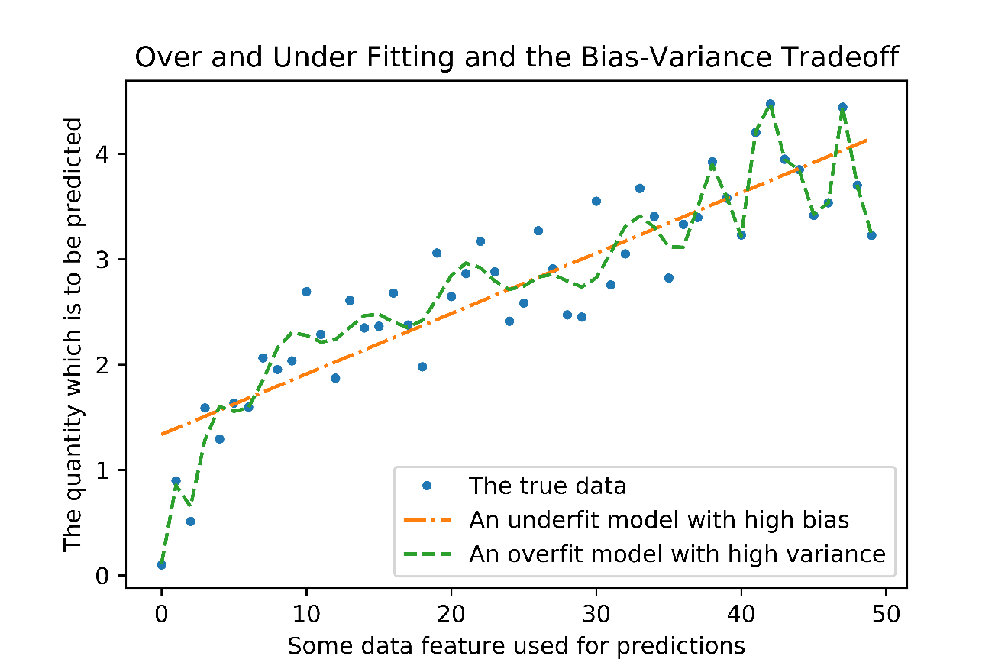
Theory: Bias-Variance Tradeoff
Convergence indicates strong generalization performance
Notes:
This slide demonstrates a few of the pitfalls which must be avoided when constructing machine learning models. If we consider some set of noisy data, represented by the blue dots in the top right figure, we can discuss the two extreme types of models which could be constructed with this data. The first model, represented by the orange line creates a linear fit. However, the trend in this data appears to be nonlinear. This orange model is said to have high bias: it has not sufficiently learned the underlying trend of the data, and therefore will have high prediction errors. A more complex model, represented by the green line successfully captures this nonlinear behavior, but also appears to be training itself to predict the stochastic noisy variations in the data. This green model is said to have high variance: it can perfectly predict a few of the noisy data points, but will have very large errors for new data points.
Another way to visualize the generalization performance of models is through the use of learning curves. These curves sequentially train models on larger numbers of training instances, cross-validate those models on a holdout set, and plot the training and cross-validation scores of the model as a function of the number of training examples given to each model. A model that has strong generalization performance will demonstrate convergence between the training and cross-validation scores, as shown in the lower learning curve. However, a model which is too complex, for instance by fitting itself to noise present in the training data, will perfectly predict the training data and have a large performance decrease on the cross-validation data, as shown in the upper left learning curve.

Slide 17
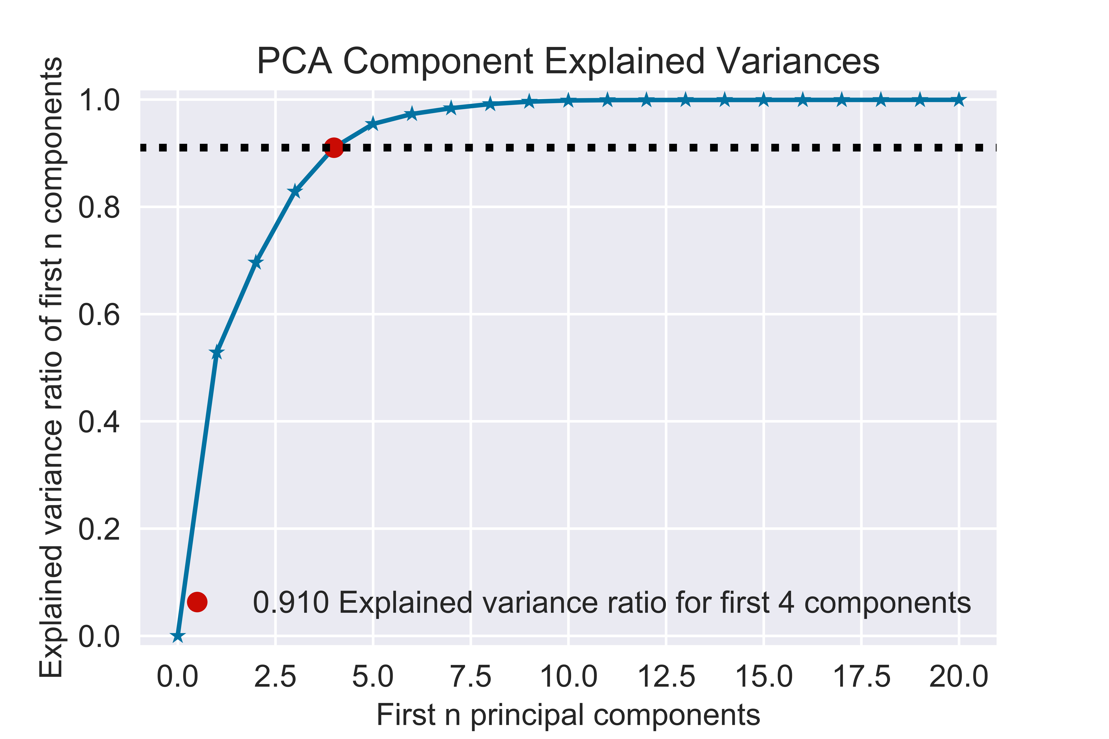
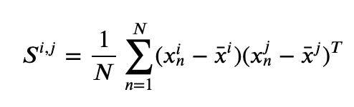
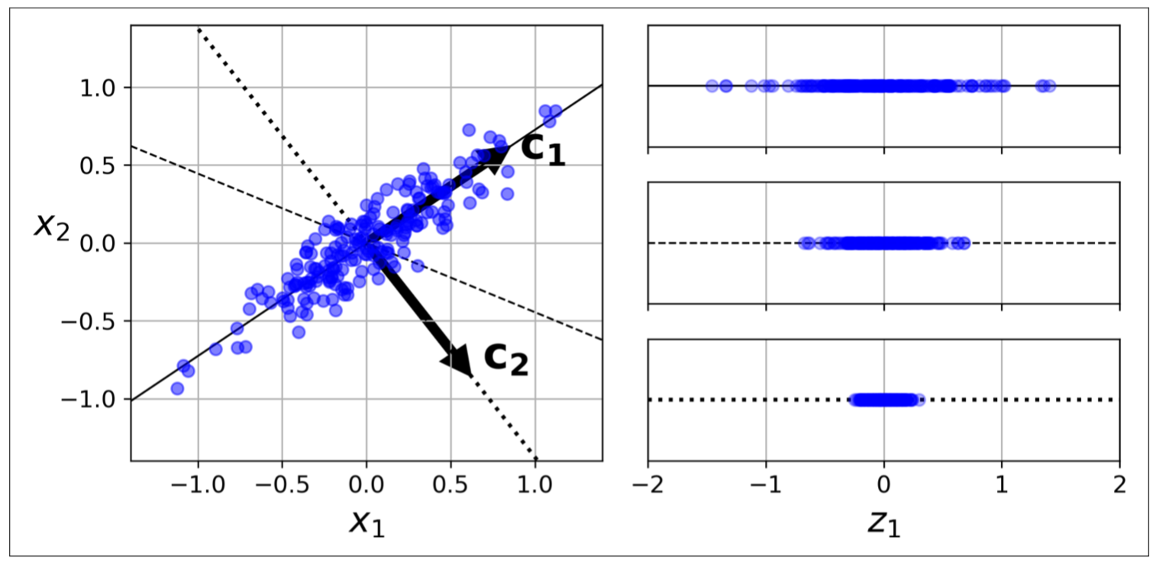
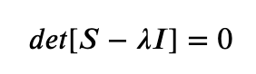
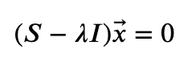
Theory: Principal Component Analysis
Decomposing the covariance matrix of the dataset yields the eigenvalues and eigenvectors where the eigenvectors are the principal components and the eigenvalues quantify the variance capture by that eigenvector.
Conceptual visualization of principal components
Notes:
Principal component analysis is an efficient method for reducing the dimensionality of a dataset through transformations into orthogonal eigenvectors which preserve the maximum possible variance in the data. The experimental data that I collected in this work has dimensions of 8,192 features by 7,000 observations. This is way too many features both for the number of observations that I have as well as the computing resources available to me. I therefore employed principal component analysis to reduce the dimensionality of the feature space significantly: from 8,192 to 10, while preserving over 99% of the inherent variance/information contained in the initial dataset.

Slide 18
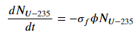
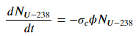
Theory: Neutron Activation Analysis
Bateman equations describe concentrations of uranium isotopes, higher actinides, and fission products.
ORIGEN solves these equations to generate the synthetic data.
Generation
from parent
(decay)
Generation
from parent
(n capture)
Generation
from fission
Loss from
n capture
Loss from
decay
Notes:
The time-dependent compositions of materials subject to neutron irradiation and subsequent decay is given by the Bateman equations. Here, I present a general form of the Bateman equation that describes all of the relevant interactions that I am concerned with in this work.

Slide 19
Methods
Simulated Data Generation:
ORIGEN simulations
Blending enrichments
Splitting into training and testing groups
Data Normalization
Noise Introduction
Experimental Measurements:
Irradiation
Gamma-ray spectrometry
Data processing:
Model construction and tuning
Model evaluation
Repeat for different scenarios

Slide 20
Methods: Simulated Data Pipeline
Oak Ridge Isotope Generation Code (ORIGEN) for zero-dimensional depletion
Tracks material composition changes and gamma radiation emissions resulting from:
Neutron field interactions (capture, fission)
Radioactive Decay
Notes:
In this section I will describe the major steps that were necessary for generating the simulated data. The synthetic data was generated via ORIGEN, which is a zero-dimensional point depletion code that tracks the coupled bateman equations describing the time-dependent composition of materials in a radiation field.

Slide 21
Methods: Oak Ridge Isotope Generation Code (ORIGEN) Simulations
Parameters:
Separate simulations for:
Each U isotope (²³⁴U, ²³⁵U, ²³⁶U, & ²³⁸U)
Each irradiation length (5 min, 1 hr, 2 hr, 3 hr, & 4 hr)
Irradiation in the Oak Ridge High Flux Isotope Reactor fast pneumatic transfer facility.
Gamma-ray emissions discretized in 100 energy bins (100 features per observation)
Computed at 180 decay times ranging from 0 to 1.8 days post-irradiation. (180 observations per isotope)
Multiple irradiation times
100 energy bins (features) [MeV]
²³⁴U | 2.50 | 2.48 | … | 0.05 | 0.03
0.00 | 5 | 3 | … | 1 | 2
0.01 | 8 | 6 | … | 9 | 0
… | … | … | … | … | …
1.79 | 9 | 7 | … | 8 | 3
1.80 | 6 | 3 | … | 2 | 1
²³⁵U | 2.50 | 2.48 | … | 0.05 | 0.03
0.00 | 5 | 3 | … | 1 | 2
0.01 | 8 | 6 | … | 9 | 0
… | … | … | … | … | …
1.79 | 9 | 7 | … | 8 | 3
1.80 | 6 | 3 | … | 2 | 1
²³⁶U | 2.50 | 2.48 | … | 0.05 | 0.03
0.00 | 5 | 3 | … | 1 | 2
0.01 | 8 | 6 | … | 9 | 0
… | … | … | … | … | …
1.79 | 9 | 7 | … | 8 | 3
1.80 | 6 | 3 | … | 2 | 1
²³⁸U | 2.50 | 2.48 | … | 0.05 | 0.03
0.00 | 5 | 3 | … | 1 | 2
0.01 | 8 | 6 | … | 9 | 0
… | … | … | … | … | …
1.79 | 9 | 7 | … | 8 | 3
1.80 | 6 | 3 | … | 2 | 1
180 decay times (observations) [d]
Four U isotopes
Notes:
This slide describes the parameters that I used when simulating data in ORIGEN. I chose to run separate ORIGEN simulations for each of the main uranium isotopes. I simulated the irradiation of 1 gram each of these four isotopes in the ORNL HFIR neutron spectrum, tracked the gamma-ray emissions across 100 energy bins from 0-2.5 MeV at 180 discrete decay times from 0-1.8 days post-irradiation.

Slide 22
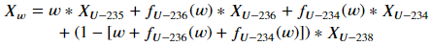
Methods: Blending Enrichments
Consider the four primary uranium isotopes:
²³⁴U, ²³⁵U, ²³⁶U, ²³⁸U
0.0055%
0.711%
99.284%
~0%
Natural uranium
Notes:
I then had to blend the results from each individual isotope to obtain the data corresponding to uranium samples of varying enrichments. This slide shows some data I found in the literature measuring the isotopic concentrations of the minor uranium isotopes U-234 and U-236 as a function of the U-235 enrichment. I obtained polynomial fits of this data to interpolate these values to other enrichments.

Slide 23
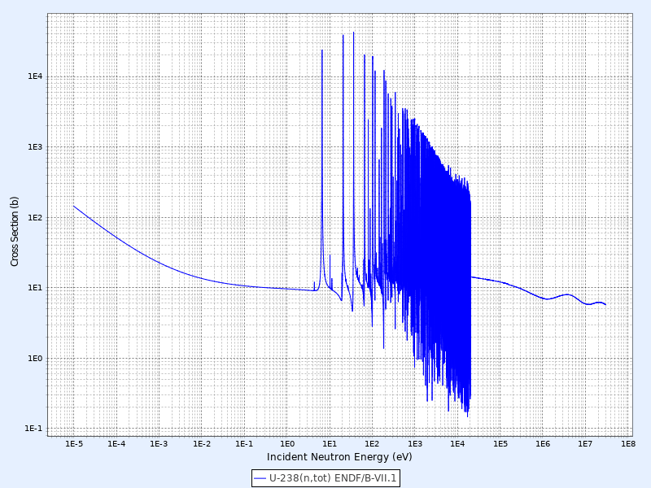
Methods: Issues with Enrichment Blending
Mono-isotopic vs multi-isotopic ORIGEN simulations.
The neutron captures resonances of one uranium isotope influence the neutron energy spectrum observed by other isotopes.
In hindsight, I should have run each enrichment level as its own ORIGEN simulation as opposed to the basis emissions I generated for each uranium isotope.
Notes:
The reason that I performed separate ORIGEN irradiations for each uranium isotope is because that allows me to create a variable dataset via post-processing in python. With the functions shown previously that describe all the isotopic concentrations as a function of U-235 enrichment, I can take the individual mono-isotopic ORIGEN results and generate data corresponding to whatever enrichment levels I want. There is, however, a physical discrepancy between this procedure and running ORIGEN simulations for each enrichment level directly. The four uranium isotopes will each influence the neutron spectrum seen by the others. In particular, the large neutron capture resonances of U-238 will alter the neutron flux profile seen by the other uranium isotopes. This phenomenon is not captured in the post-processing of mono-isotopic data method previously described. To overcome this I could have just brute forced my way through, say, 100 ORIGEN simulations for 100 unique enrichment levels.

Slide 24
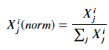
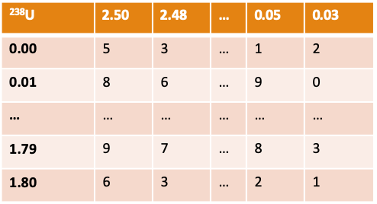
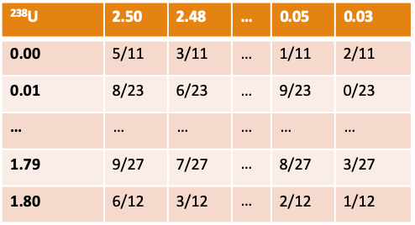
Methods: Data Normalization
Removes dependence on total activity, which is proportional to enrichment.
Eliminates the influence of uncertain sample masses, neutron fluence, counting distances, etc. from corrupting results.
100 energy bins (features) [MeV]
180 decay times (observations) [d]
Notes:
Pretty much just read the slide.

Slide 25
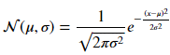
Methods: Gaussian Noise Introduction
The simulated data is free of statistical errors.
We add errors via Gaussian Noise to replicate experimental data counting statistics.
Bias of 0 and standard deviation of 5%.
100 energy bins (features) [MeV]
²³⁸U | 2.50 | 2.48 | … | 0.05 | 0.03
0.00 | 5/11 | 3/11 | … | 1/11 | 2/11
0.01 | 8/23 | 6/23 | … | 9/23 | 0/23
… | … | … | … | … | …
1.79 | 9/27 | 7/27 | … | 8/27 | 3/27
1.80 | 6/12 | 3/12 | … | 2/12 | 1/12
²³⁸U | 2.50 | 2.48 | … | 0.05 | 0.03
0.00 | 5.1/11 | 3.2/11 | … | 0.9/11 | 2.1/11
0.01 | 7.8/23 | 6.1/23 | … | 9.2/23 | 0.1/23
… | … | … | … | … | …
1.79 | 8.8/27 | 7.1/27 | … | 8.1/27 | 3.2/27
1.80 | 5.7/12 | 3.1/12 | … | 2.1/12 | 1.1/12
180 decay times (observations) [d]
Notes:
Pretty much just read the slide.

Slide 26
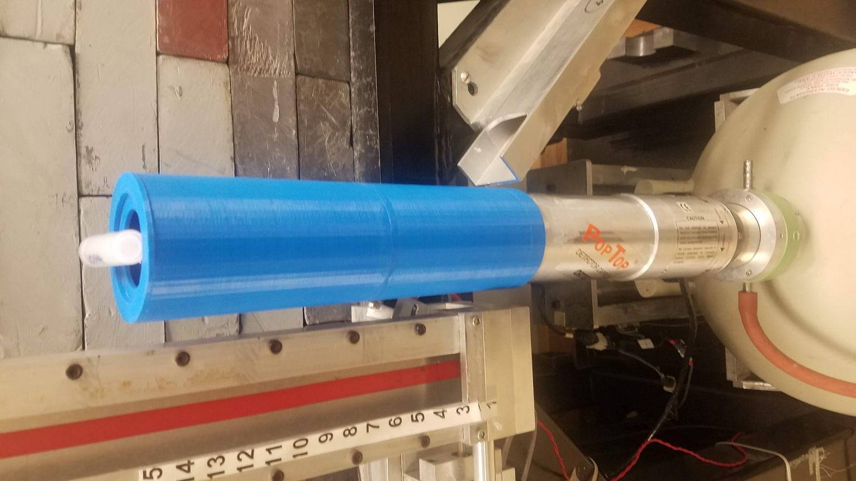
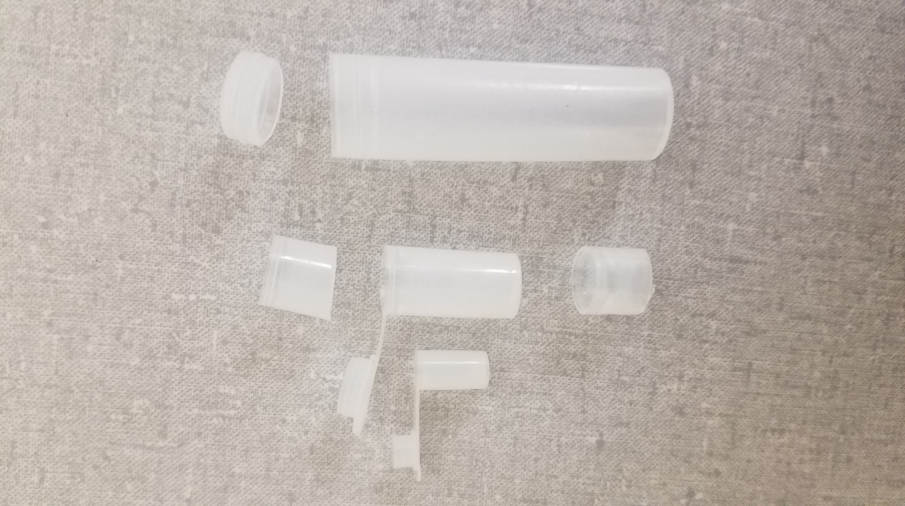
Methods: Experimental Measurements
Internal ID | NBL CRM | Mass [mg] | Atom % ²³⁵U | Atom % ²³⁸U | Atom % ²³⁴U | Atom %²³⁶U
V0322 | U-129A | 4.99 | 0.72087 ±0.00039 | 99.27382 ±0.00039 | 0.0052962±.0000038 | 0.0000097±.0000012
V0324 | U030A | 5.06 | 3.0404 ±0.0016 | 96.9312 ±0.0016 | 0.02778 ±0.00006 | 0.000599 ±0.000005
V0328 | U0002 | 5.03 | 0.01755 ±0.00005 | 99.9823 ±0.0001 | 0.00016 ±0.00001 | <.00001
V0332 | U0200 | 5.04 | 20.013 ±0.020 | 79.651 ±0.021 | 0.1246 ±0.0003 | 0.2116 ±0.0006
V0336 | U500 | 4.94 | 49.696 ±0.050 | 49.711 ±0.050 | 0.5181 ±0.0008 | 0.0755 ±0.0003
V0340 | U630 | 5.07 | 63.353 ±0.020 | 35.066 ±0.020 | 0.61894 ±0.00043 | 0.96230 ±0.00067
V0344 | U970 | 4.91 | 97.663 ±0.003 | 0.5229±.0006 | 1.6653 ±0.0017 | 0.1491 ±0.0005
Samples of 5 mg each prepared in vials.
Irradiation for 5 minutes at 10 kW in 3L epithermal irradiation facility.
Decayed for 8 hours prior to measurement.
Counted with a 25 cm spacer to limit detector dead-time < 20% for highest U enrichment.
50 hours of gamma-ray spectrometry with individual spectra saved every 3 minutes (1,000 observations per enrichment).
Ortec Maestro used for gamma-ray spectrometry data acquisition with 8,192 discrete energy bins.

Slide 27
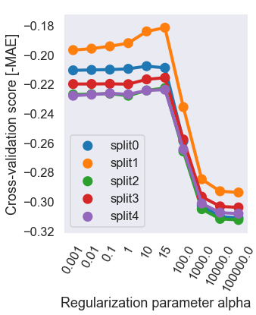
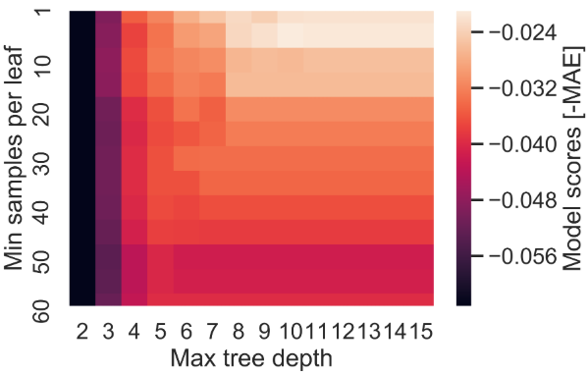
Methods: Tuning via grid search & cross-validation
Ridge Regression Grid Search
Decision Tree Multi Parameter Grid Search
The Cross-Validation Procedure

Slide 28
Results
Simulations
Fixed t_{irr}
Compare the algorithms to each other
Variable t_{irr} and training/testing mismatches
Characterize model generalization performance
Experimental Measurements
Down-binning method for data truncation
PCA method for data truncation
Alternative method to down-binning for data truncation

Slide 29
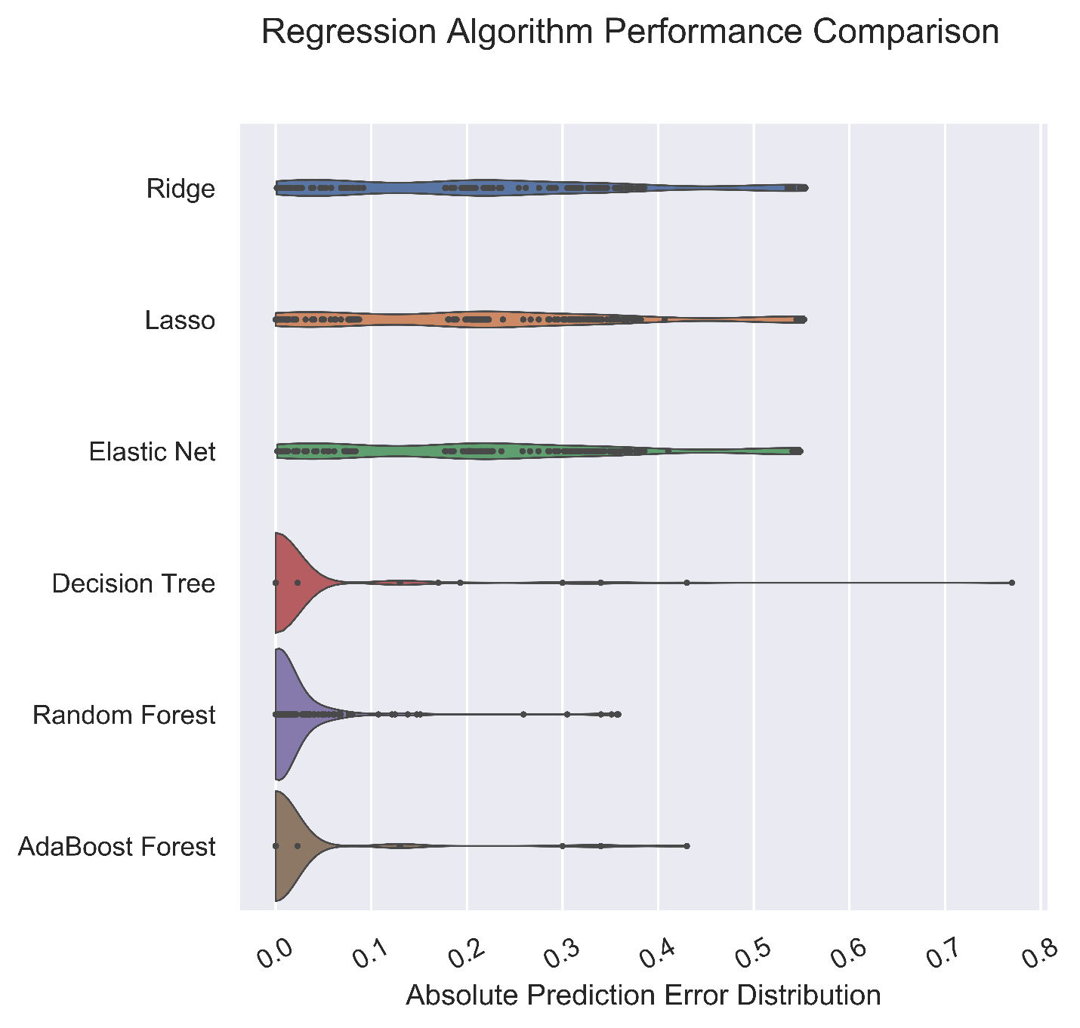
Results: Simulations – Fixed t_{irr}
Decision trees and ensemble models had best performance
Model | MAE | Std. dev.
Ridge | 0.216 | 0.168
Lasso | 0.216 | 0.171
Elastic Net | 0.216 | 0.170
Decision Tree | 0.019 | 0.076
Random Forest | 0.018 | 0.051
Adaptive Boosting | 0.017 | 0.070

Slide 30
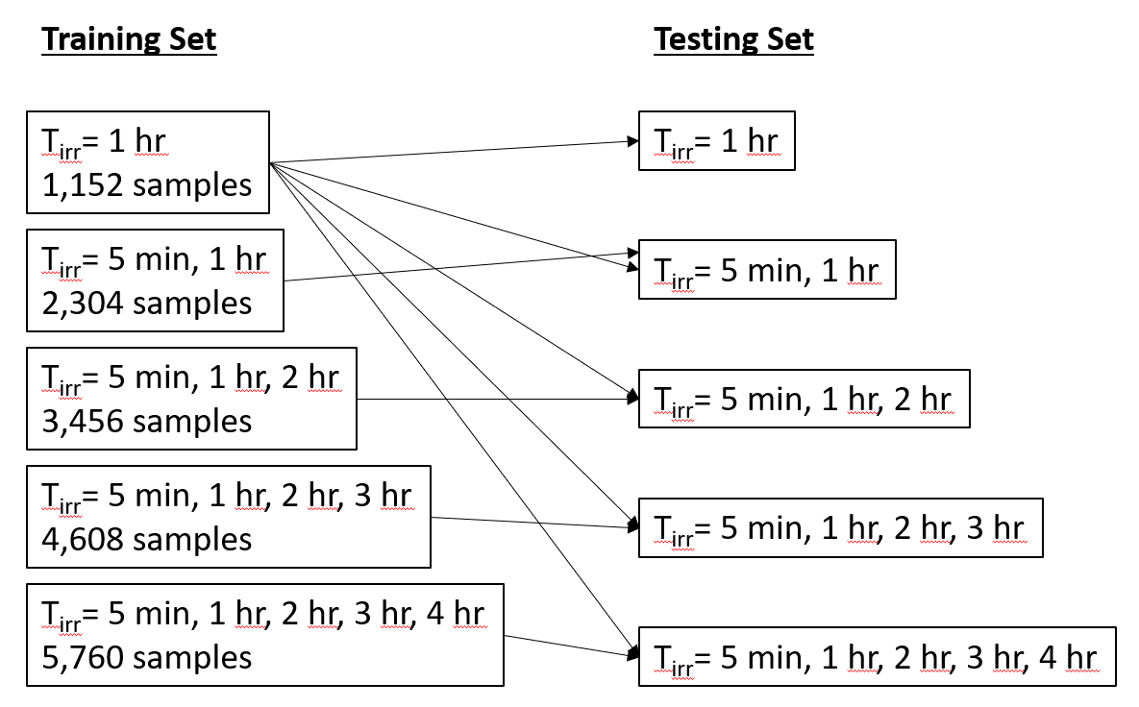
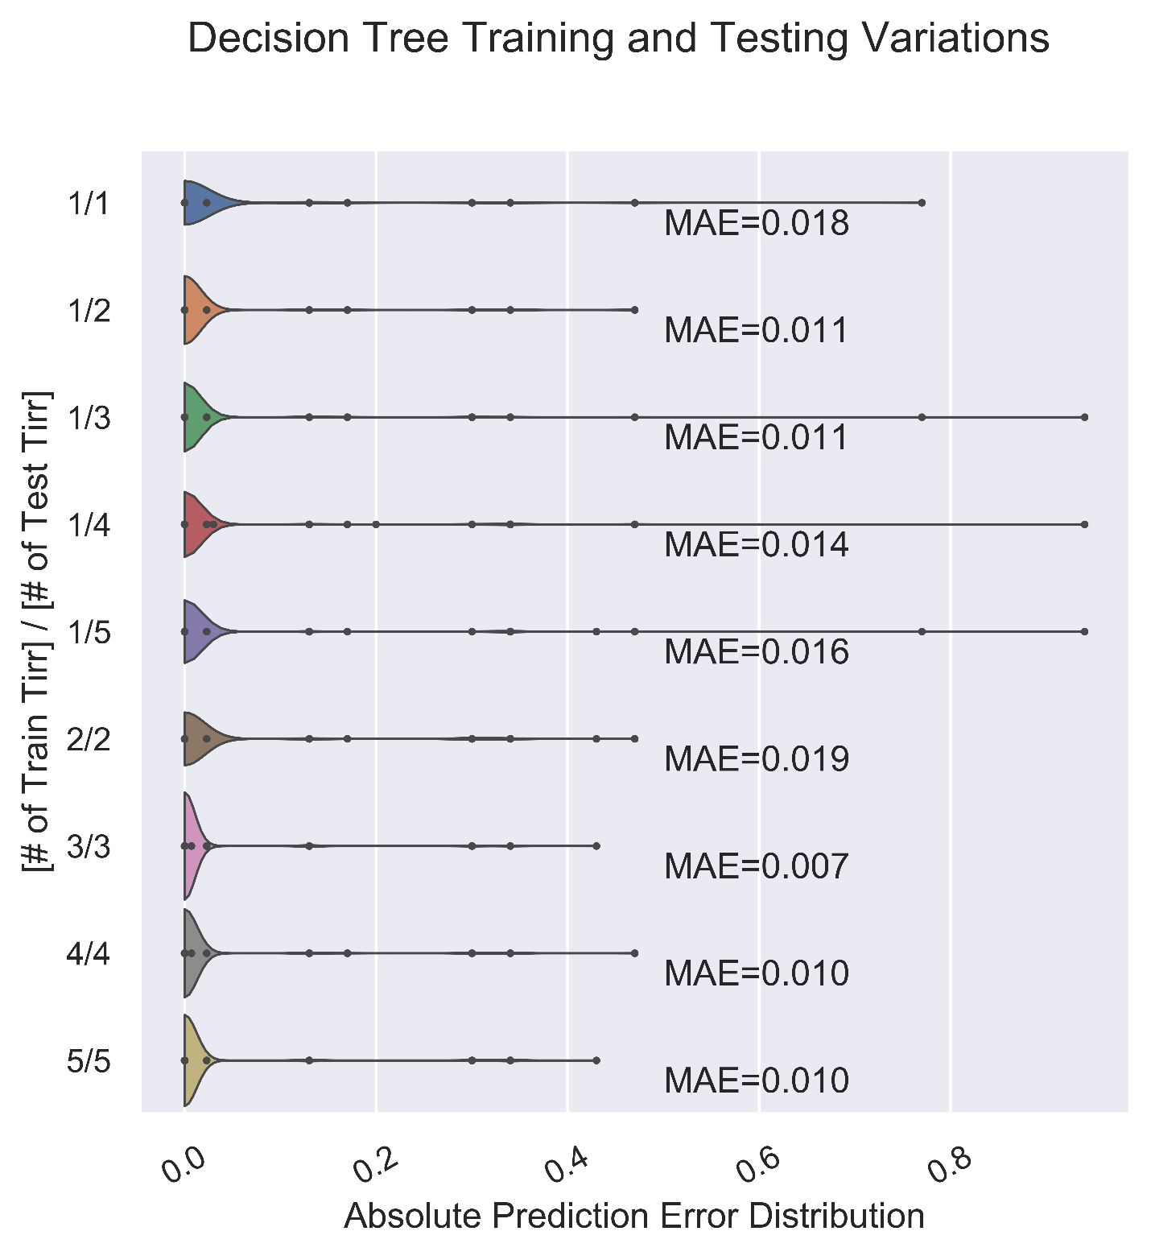
Results: Simulated Data – Training/Testing Data Mismatches
Invariant performance across the ranges considered!
How much further could these ranges be extended?
Which other parameters could be allowed to be unconstrained?

Slide 31
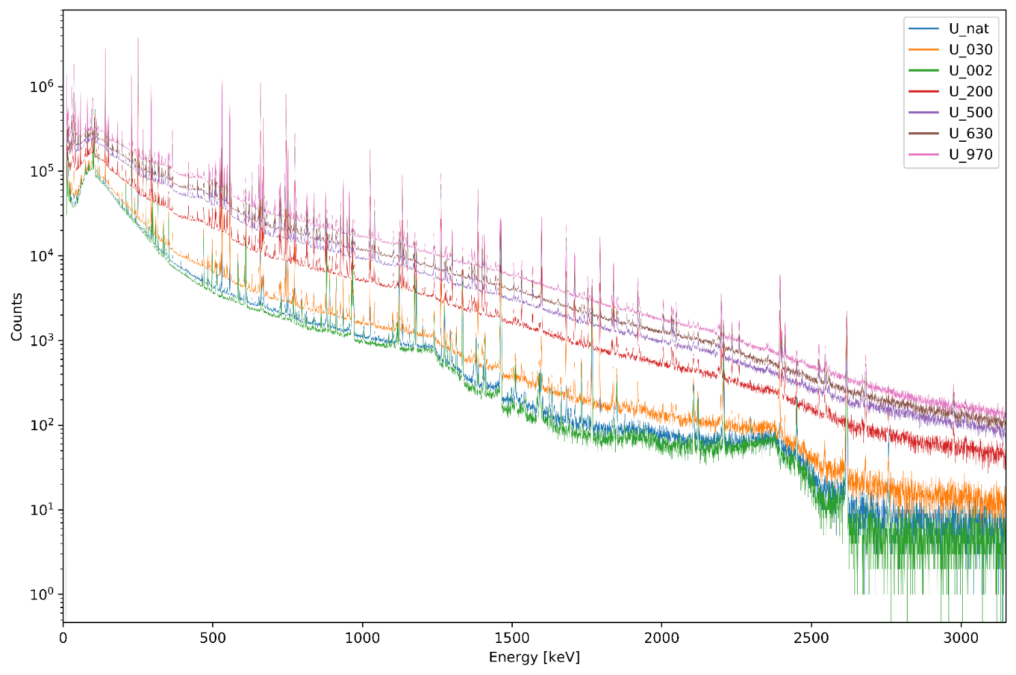
Results: Experimental Data – Spectra Visualization
This figure shows the full 50-hour gamma-ray spectra for each of the seven enrichment levels experimentally measured.
Intuition check - enrichment correlated with total activity.
Each of these seven spectra contains 1,000 three-minute spectra.

Slide 32
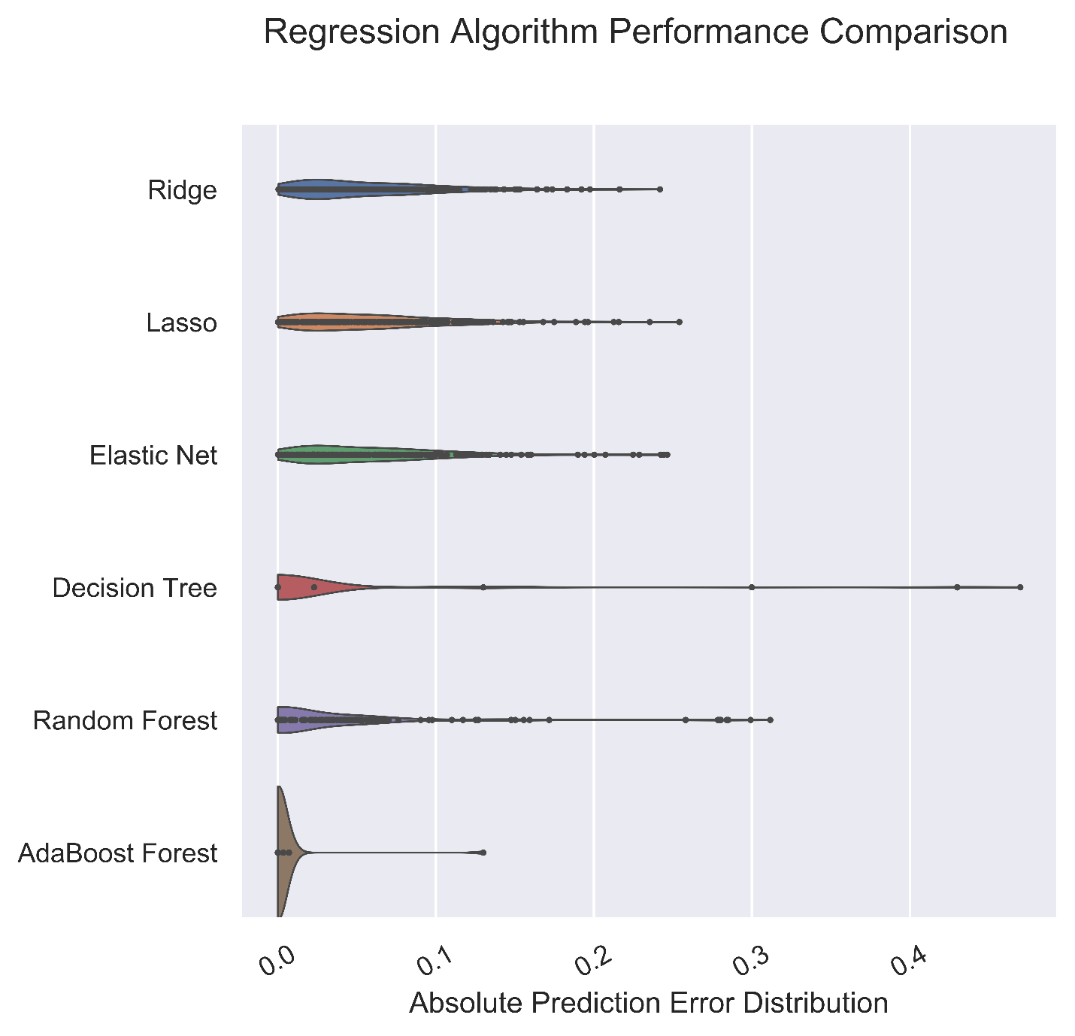
Results: Experimental Data – Down-Binning Method for Data Truncation
Linear models are now competitive
Decision tree simple structure
Energy binning factor of 64 (128 energy bins)
Spectrum binning factor of 5 (15 minute spectra)
Model | MAE | Std. Dev.
Ridge | 0.0566 | 0.0454
Lasso | 0.0590 | 0.0467
Elastic Net | 0.0587 | 0.0480
Decision Tree | 0.0227 | 0.0818
Random Forest | 0.0302 | 0.0577
Adaptive Boosting | 0.0028 | 0.0155

Slide 33
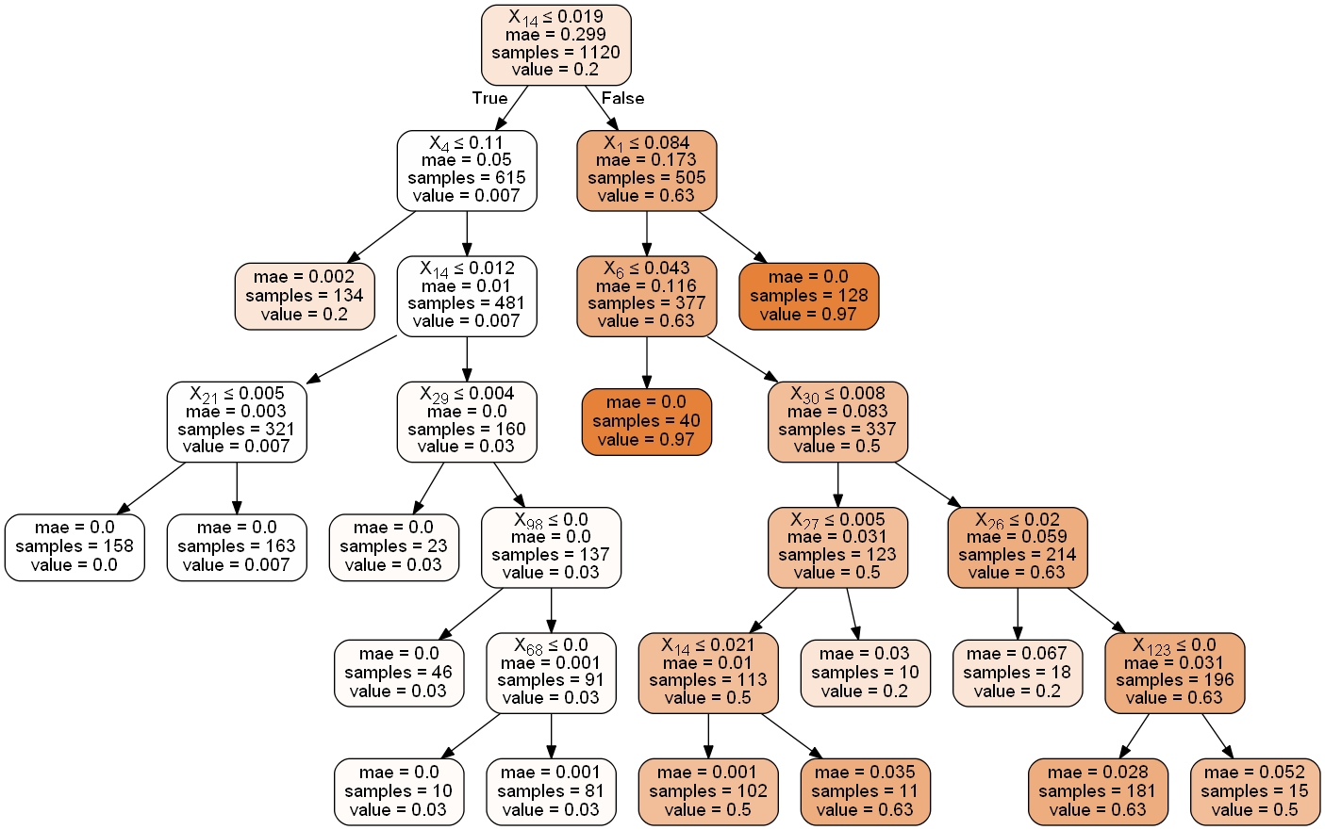
Results: Experimental Data – Down-Binning Method for Data Truncation

Slide 34
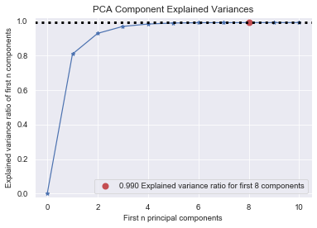
Results: Experimental Data – Principal Component Analysis for Data Truncation
Compressed 8,192 energy bin data to 10 principal components to account for >99% of variance

Slide 35
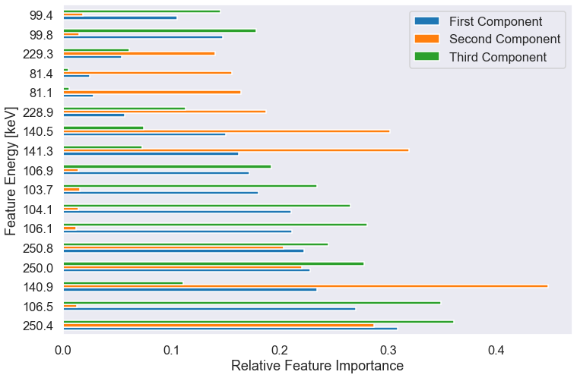
Results: Experimental Data – Principal Component Analysis for Data Truncation
Plot of top 10 features of each of the top three principal components
Important energies:
100 keV
228 keV
81 keV
140 keV
250 keV
Notes:
Add a table listing the photopeaks and responsible nuclides.

Slide 36
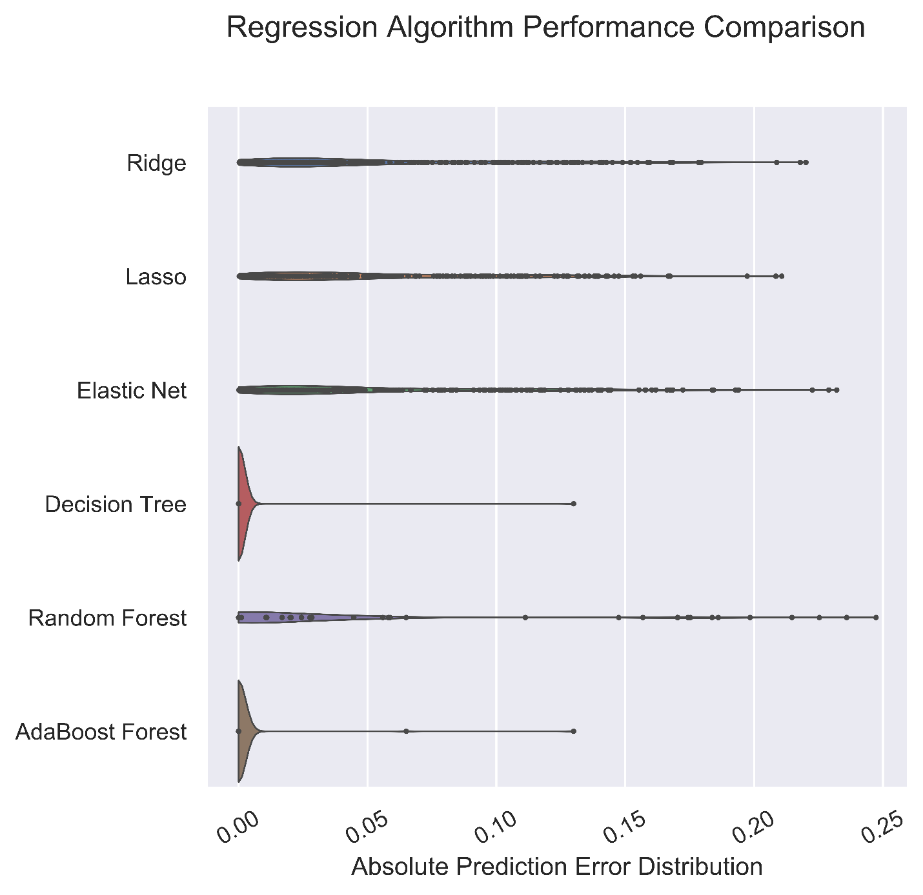
Results: Experimental Data – Principal Component Analysis for Data Truncation
Model | MAE | Std. Dev.
Ridge | 0.0530 | 0.0474
Lasso | 0.0534 | 0.0452
Elastic Net | 0.0529 | 0.0505
Decision Tree | 0.0005 | 0.0078
Random Forest | 0.0299 | 0.0546
Adaptive Boosting | 0.0007 | 0.0087
Significant performance improvement for decision tree and adaptive boosting!

Slide 37
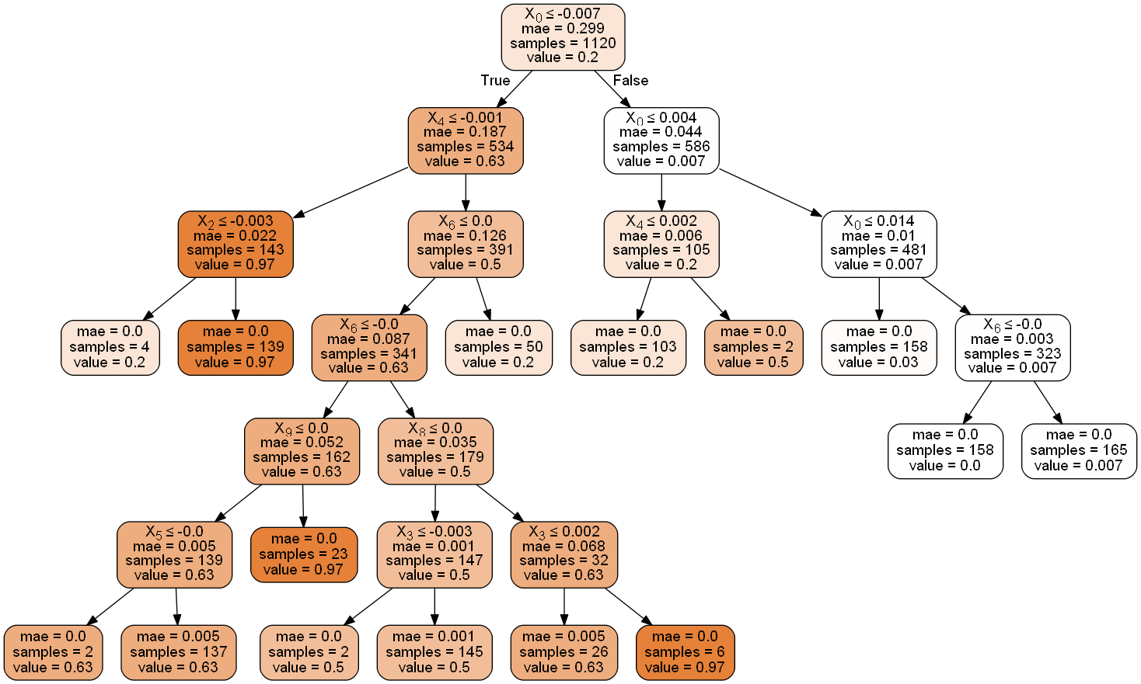
Results: Experimental Data – Principal Component Analysis for Data Truncation
The single best model overall: a decision tree based on experimental data with PCA pre-processing and MAE score of 0.05%.

Slide 38
Comparison of Feature Importances
Photopeak | Parent | Mandel et al. | Simulations | Experimental
105 keV | ²³⁹Np | Y | Y | Y
210 keV | ²³⁹Np | Y
278 keV | ²³⁹Np | Y
228 keV | ²³⁹Np |  |  | Y
140 keV | ⁹⁹Mo | Y | Y | Y
530 keV | ¹³³I | Y
556 keV | ⁹⁹Y | Y
658 keV | ⁹⁷Nb | Y | Y
743 keV | ⁹⁷Nb | Y
773 keV | ¹³²I | Y | Y
81 keV | ¹³³Xe |  |  | Y
250 keV | ¹³⁵Xe |  |  | Y
Conclusion: There are many (similar) ways to solve this problem!
Notes:
As you can see, there are similarities between the features identified in the different enrichment determination scenarios that have been considered in this presentation. In particular, a photon from Np-239 and a photon from Mo-99 were both selected by Mandel et al., the models I built on simulated data, and the models I built on experimental data. This is strong evidence to support the notion that these models are identifying true relationships in the data that are supported by the literature, but using that data more effectively to make decay time (and irradiation time) invariant predictions.

Slide 39
Conclusions
Summary of Results
Models achieved MAE scores as low as 0.05%.
Models were shown to have performance invariant across:
A 50 hour range of decay times
Training/testing mismatches of irradiation times
Decreased sampling density in the training set.
Principal Component Analysis is an effective technique for data truncation that does not degrade model performance.
These results demonstrate that this method is promising for other applications.
Impact on Scientific Community
Encourage adoption of machine learning in additional nuclear engineering applications.
Improve existing analysis routines in nuclear safeguards with data fusion based predictive modeling.
Provide an outline of the procedure including necessary steps and best practices for model construction.
Notes:
This slide presents a summary of the results shown in this presentation, and discusses the broader impact and implications that these results should have on the scientific community.

Slide 40
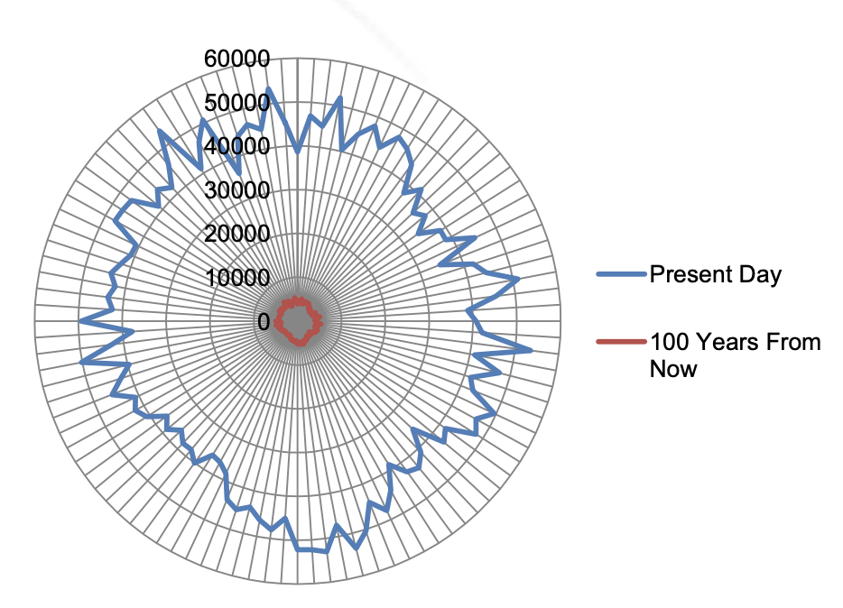
Future Work: Data Fusion of Modern NDE Techniques for Nuclear Safeguards
Re-Verification of Spent Nuclear Fuel
INL Compton Dry-Cask Imaging System
Measures ratio of scattered to unscattered gamma-rays
LANL BN-350 Dual Slab Verification Detector
Measures neutrons from the sides of the cask
LLNL Radiation Imaging
Uses thermal neutrons and gamma rays to produce images of cask contents
A combination of data streams from each of these methods could be improved by the methods developed in this work.
Two sample neutron fingerprints for the same cask at different times.
Notes:
I would now like to pitch a brief proposal for future work which extends the methods I have developed here to improve on existing real-world experimental facilities for identification and characterization of spent nuclear fuel canisters. The particular application that I am considering here is the re-verification of spent nuclear fuel. There are currently several experimental facilities which collect unique “fingerprints” of individual spent nuclear fuel dry storage casks. These “fingerprints” are uniquely identifying sets of either gamma-ray or neutron measurements at specific locations around the cask. Each cask can be identified via its fingerprint, and the fingerprints are sensitive to the removal of a single fuel element.
My proposal considers the possibility of fusing the data streams from several of these fingerprinting technologies and incorporating them into a more sophisticated data pipeline to study the characteristics of these fingerprints as predictive indicators of important material properties such as: burnup, cooling time, enrichment, etc.

Slide 41

Compton Dry Cask Imaging System
System for re-verifying spent LWR fuel in vertical dry storage casks.
Top-down gamma-ray spectrometry above each individual fuel element.
Ratio of scattered to un-scattered photons at each point establishes the “fingerprint”.
Can detect if individual fuel pins are missing.
Notes:
The first fingerprinting system used for re-verification of spent nuclear fuel dry storage casks is the Compton Dry Cask Imaging System.

Slide 42
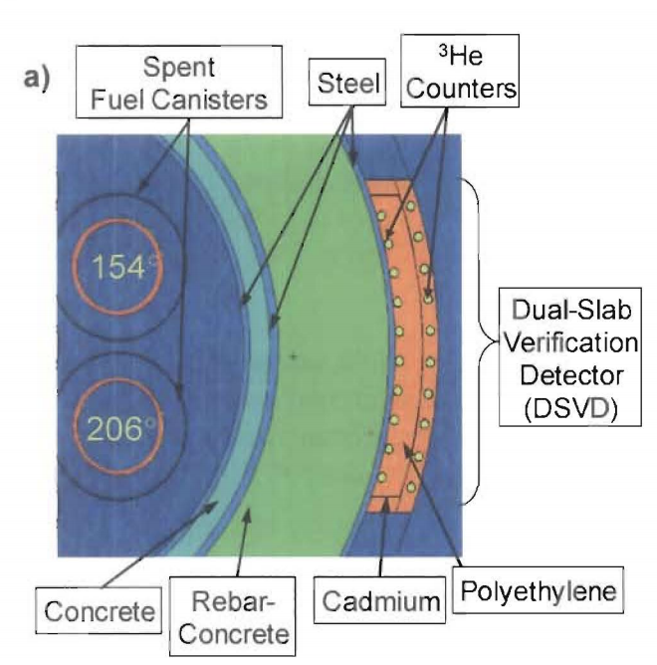
Dual Slab Verification Detector
Dry storage safeguards system for BN-350 fast reactor spent fuel
“Continuity of Knowledge”
Two rows of ³He tubes along exterior perimeter of spent fuel casks
Measures the neutron flux at 50-100 locations to establish a “fingerprint”
Assumptions:
Entire cask loaded in single reactor outage
Assemblies in one cask have similar burnups with only location based difference (<5%).
Entire cask has same power history (# of shutdowns, shuffle pattern, etc.)
Neutrons that exit are primarily emitted from outer ring of assemblies
Top view of the dual-use cask with the dual-slab verification detector.
Notes:
The next re-verification system is the Dual Slab Verification Detector.

Slide 43





Future Work: Data Fusion of CDCIS & DSVD
Given a set of fingerprint measurements for many spent fuel canisters with known properties (enrichment, cooling time, burnup, etc.):
50-100 perimeter neutron flux measurements from DSVD
Individual fuel pin scattered/unscattered photon ratios from CDCIS
Can we use these fingerprint features to generate models which can predict these known properties in new canisters?
From unique “fingerprints” to trends in multi-fingerprint composition which are indicative of important material properties.
Fingerprint trends representative of important quantities
*
Data-fused
fingerprint
Dataset of fingerprints labeled by material properties
CDCIS
DSVD
* Using the procedure I developed in this work.
gammas
neutrons

Slide 44



Acknowledgements
This work was sponsored in part by the NNSA Office of Defense Nuclear Nonproliferation R&D through the Consortium for Nonproliferation Enabling Capabilities
This work was sponsored in part by the Cockrell School of Engineering Thrust Fellowship

Slide 45
References
1. Aubert, G. & Lansdorp, P. M. Telomeres and Aging. Physiol. Rev. 557–579 (2009). doi:10.1152/physrev.00026.2007
2. Pedregosa, F., Weiss, R. & Brucher, M. Scikit-learn: Machine Learning in Python. J. Mach. Learn. Res. 12, 2825–2830 (2011).
3. Breiman, L. Random Forests. Mach. Learn. 5–32 (2001). doi:10.1023/A:1010933404324
4. M Mantel, J Gilat, S Amiel, (Nuclear chemistry department, Soreq Nuclear Research Center, Yavne, I. Isotopic analysis of uranium by neutron activation and high resolution gamma-ray spectrometry. 2, (1969).
5. Hata, H. et al. Application of support vector machine to rapid classification of uranium waste drums using low-resolution γ-ray spectra. Appl. Radiat. Isot. 104, 143–146 (2015).
6. Drescher, A. et al. Gamma-gamma coincidence performance of LaBr3_Ce scintillation detectors vs HPGe detectors in high count-rate scenarios. Appl. Radiat. Isot. 122, 116–120 (2017).
7. Shuryak, I. Advantages of synthetic noise and machine learning for analyzing radioecological data sets. PLoS One 12, 1–20 (2017).
8. Park, K. J. et al. Determination of burnup and Pu/U ratio of PWR spent fuels by gamma-ray spectrometry. Nucl. Eng. Technol. 41, 1307–1314 (2009).
9. Tian, C., Guo, H., Lv, N., Xu, P. & Lv, W. Analysis on enrichment and mass of uranium materials with time-correlated measurement. Health Phys. 113, 387–391 (2017).
10. Jones, A. E., Turner, P., Zimmerman, C. & Goulermas, J. Y. Classification of spent reactor fuel for nuclear forensics. Anal. Chem. 86, 5399–5405 (2014).
11. Robel, M. et al. A composite position independent monitor of reactor fuel irradiation using Pu, Cs, and Ba isotope ratios. J. Environ. Radioact. 195, 9–19 (2018).
12. Meier, D. et al. Contract No : Office of Environmental Management ( EM ). Disclaimer : Multi-Isotope Process ( MIP ) Monitor Deployment at H-Canyon.
13. Dayman, K. J., Coble, J. B., Orton, C. R. & Schwantes, J. M. Characterization of used nuclear fuel with multivariate analysis for process monitoring. Nucl. Instruments Methods Phys. Res. Sect. A Accel. Spectrometers, Detect. Assoc. Equip. 735, 624–632 (2014).
14. Åberg Lindell, M. et al. Discrimination of irradiated MOX fuel from UOX fuel by multivariate statistical analysis of simulated activities of gamma-emitting isotopes. Nucl. Instruments Methods Phys. Res. Sect. A Accel. Spectrometers, Detect. Assoc. Equip. 885, 67–78 (2018).
15. Durst, P. C. Guidance for Independent Spent Fuel Dry Storage Installations. 1–22 (2012).
16. Meyer, R. M. Nondestructive Examination Guidance for Dry Storage Casks. (2016).
17. Kamuda, M., Zhao, J. & Huff, K. A comparison of machine learning methods for automated gamma-ray spectroscopy. Nucl. Instruments Methods Phys. Res. Sect. A Accel. Spectrometers, Detect. Assoc. Equip. (2018). doi:10.1016/j.nima.2018.10.063
18. Zhang, Y., Wang, S., Phillips, P. & Ji, G. Binary PSO with mutation operator for feature selection using decision tree applied to spam detection. Knowledge-Based Syst. 64, 22–31 (2014).
19. Bordarie, J. Predicting intentions to comply with speed limits using a ‘decision tree’ applied to an extended version of the theory of planned behaviour. Transp. Res. Part F Traffic Psychol. Behav. 63, 174–185 (2019).
20. Li, Y. et al. Random forest regression for online capacity estimation of lithium-ion batteries. Appl. Energy 232, 197–210 (2018).
21. Chen, W., Sun, Z. & Han, J. Landslide susceptibility modeling using integrated ensemble weights of evidence with logistic regression and random forest models. Appl. Sci. 9, (2019).
22. Chen, Y. et al. Estimating deciduous broadleaf forest gross primary productivity by remote sensing data using a random forest regression model. J. Appl. Remote Sens. 13, 1 (2019).
23. Chihab, Y., Bousbaa, Z., Chihab, M., Bencharef, O. & Ziti, S. Algo-Trading Strategy for Intraweek Foreign Exchange Speculation Based on Random Forest and Probit Regression. Appl. Comput. Intell. Soft Comput. 2019, 1–13 (2019).
24. Chattopadhyay, M. A Comprehensive Review and Meta-Analysis on Applications of Machine Learning Techniques in Intrusion Detection. Australas. J. Inf. Syst. 22, 1–27 (2018).
25. Ng, A. Y. Feature selection, L ₁ vs. L ₂ regularization, and rotational invariance. Twenty-first Int. Conf. Mach. Learn. - ICML ’04 78 (2004). doi:10.1145/1015330.1015435
26. Géron, A. Hands-on machine learning with Scikit-Learn and TensorFlow: concepts, tools, and techniques to build intelligent systems. Hands-on machine learning with Scikit-Learn and TensorFlow: concepts, tools, and techniques to build intelligent systems (2017).
27. Burkov, A. The 100-Page Machine Learning Book. Expert Systems 5, (2019).
28. Singh, S. Understanding the Bias-Variance Tradeo. Towards Data Science 1–5 (2019). Available at: https://towardsdatascience.com/understanding-the-bias-variance-tradeoff- 165e6942b229.
29. Joseph Rocca. Ensemble methods: bagging, boosting and stacking. Towards Data Science 1–21 (2019).
30. Hastie, T., Tibshirani, R. & Friedman, J. Elements of Statistical Learning. Revista Espanola de las Enfermedades del Aparato Digestivo 26, (2009).
31. Brieman, L., Freidman, Olshen & Stone. Classification and Regression Trees. (1984).
32. T.K.~Ho. The Random Subspace Method for Constructing Decision Forests. IEEE Trans. Pattern Anal. Mach. Intell. 20, 832–844 (1998).
33. Freund, Y. & Schapire, R. E. Experiments with a New Boosting Algorithm. Proc. 13th Int. Conf. Mach. Learn. 148–156 (1996). doi:10.1.1.133.1040
34. Halko, N., Martinsson, P. G. & Tropp, J. A. Finding structure with randomness: Probabilistic algorithms for constructing approximate matrix decompositions. SIAM Rev. 53, 217–288 (2011).
35. Sehgal, B. R. Light water reactor safety. A historical review. Nucl. Saf. Light Water React. 1–88 (2012). doi:10.1016/B978-0-12-388446-6.00001-0
36. Gilmore, G. Practical Gamma-ray Spectrometry 2nd Edition. Training (2008). doi:10.1002/9780470861981
37. Wieselquist, W. A. The scale 6.2 origen API for high performance depletion. Math. Comput. Supercomput. Nucl. Appl. Monte Carlo Int. Conf. M C+SNA+MC 2015 4, 2789–2799 (2015).
38. Nuclear Materials Disposition Program Office Y-12 Plant Defense Program. HEU to LEU Conversion and Blending Facility UNH Blending Alternative to Produce LEU UNH for Commercial Use. 13675, (1995).
39. Santi, P. A., Browne, M. C., Parker, R. F. & Williams, R. B. Testing of the Dual Slab Verification Detector for Attended Measurements of the BN-350 Dry Storage Casks. 836, (2009).

Slide 46
Thank you!
Questions?

Slide 47
Appendix
Methods: Splitting data into training and testing groups
Shortcomings/Future Work
Note on computational complexity
Scoring metric – mean absolute error (MAE)
Simulated data models (learning curves and feature importances)
Experimental data models with down-binning (learning curves and feature importances)
Experimental data models with PCA data truncation (learning curves only)
High level project summary
Gamma-ray spectrometry
Top three principal components plotted

Slide 48
Shortcomings/Future Work
Perform more feature engineering by generating “meta-features”, for instance:
Ratios of energy bin counts
Form variable features representing each photopeak by combining energy bins
Consider other algorithms such as:
Support vector regression
Neural networks
K neighbors
Ensembles of varied algorithms
Brute force model construction on the full experimental dataset (8,192 bins x 7,000 instances) without down-binning
Finer resolution ORIGEN simulations (“patches method”) by sampling subspaces of the energy and decay time regimes
Direct ORIGEN simulations for each enrichment level
Couple detector response functions into ORIGEN output to realistically simulate experimental measurements and compare results

Slide 49
Methods: Splitting data into training and testing groups
Num. of irradiation times | Total dataset size | Fixed X_{train} | Fixed X_{train} / X_{test}
1 | 1440 | 1152 | 1152
2 | 2880 | 1152 | 2304
3 | 4320 | 1152 | 3456
4 | 5760 | 1152 | 4608
5 | 7200 | 1152 | 5760

Slide 50
Note on computational complexity
Algorithm | Training Complexity | Prediction Complexity
Regularized Linear | O(p²n+p³) | O(p)
Decision Tree | O(pnlog(n)) | O(p)
Random Forest | O(pn_{trees}nlog(n))/c | O(pn_{trees})
Regularized Random Forest | O(fn_{trees}nd)/c | O(pn_{trees})
Adaptively Boosted Forest | O(pn_{trees}nlog(n)) | O(pn_{trees})
n = number of samples
log(n) = assumed average depth of unrestricted tree
p = number of features
n_{trees} = number of trees in random forest
d = maximum tree depth
f = number of features to evaluate per node
c = number of available processors
www.thekerneltrip.com/machine/learning/computational-complexity-learning-algorithms/
April 16th, 2018.

Slide 51
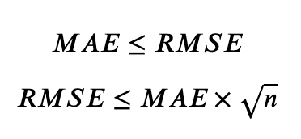
Scoring Metric – Mean Absolute Error (MAE)
Advantages of MAE over RMSE:
Easier to interpret
No dependence on sampling size
Disadvantages:
Weights small errors the same as large errors.
Discontinuous gradient.
Upper and lower bounds on RMSE vs MAE

Slide 52
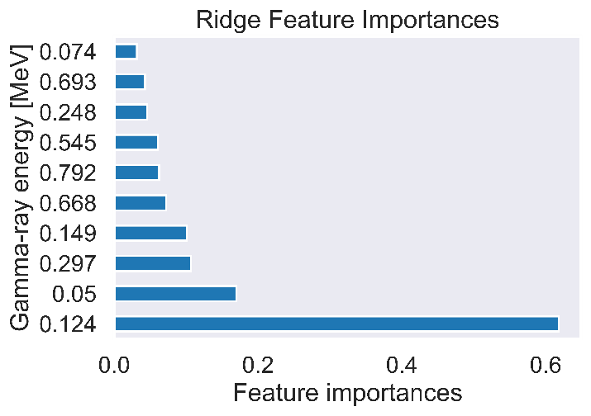











Simulated Data Models

Slide 53












Down-binned experimental data

Slide 54






PCA on experimental data

Slide 55
Introduction: High-Level Project Summary
Generating a sufficiently broad database of gamma-ray measurements which captures the variations in enrichments, irradiation times, and decay times that we wish to consider.
Preparing and formatting of the gamma-ray database for use in machine learning.
Selecting of machine learning algorithms to use for model construction.
Optimizing the hyperparameters of the models during training, coupled with cross-validation and grid searches.
Extracting fundamental insights to the relationships in the gamma-ray data which most strongly correlate with uranium enrichment.
Evaluating the ultimate models generated by each algorithm and characterization of their performances using scoring metrics.
Comparing of the performance of models in scenarios of single and double unconstrained values: (t_{dec} vs t_{dec} and t_{irr}).

Slide 56



Theory: Gamma-Ray Spectrometry
Detector energy resolution
Detector efficiency
Detector dead-time
Band structure of solids
Gilmore, Practical Gamma-Ray Spectrometry

Slide 57

Visualization of top 3 principal components

